Slide 1
MODULE 9
Crop Management in Agroecology
www.eu-dare.com

Slide 2
Content overview
You will explore different techniques which involve strategically combining crops to maximize space and resources while promoting mutual benefits among plants. You will learn also about sustainable methods to maintain and enhance soil fertility, and finally you will discover how rotating different crops in a specific sequence can improve soil structure, break pest and disease cycles, and enhance overall farm productivity.
01
Introduction
02
Sustainable Crop Management Practices
03
Crop Diversification and Polyculture Systems
04
Crop Succession and Rotation
05
Agroecological Practices for Nutrient Management on a Farm

Slide 3
Think how different crop management practices can contribute to both sustainable agriculture and environmental conservation, considering how these methods may reshape the way we view modern farming...

Slide 4
01
Introduction

Slide 5
Introduction
Agroecology is a holistic approach to agriculture that seeks to harness the natural synergies between different components of the agricultural ecosystem. By integrating crop management and livestock, it aims to create resilient, productive, and sustainable agricultural systems that not only provide food security but also protect our environment and enhance biodiversity.
a return to the roots of traditional farming
a leap forward in innovative, sustainable agriculture
&

Slide 6
We don't inherit the earth from our parents, we borrow it from our children.
Wendell Berry

Slide 7
02
Sustainable Crop Management Practices

Slide 8
Agroecological Approaches to Crop Management
Agroecological approaches to sustainable cropping are built on a set of foundational assumptions that distinguish them from conventional, input-intensive agricultural practices. These assumptions are deeply rooted in the understanding of ecological processes and the belief in working alongside nature.

Slide 9
Sustainable Crop Management Practices - B
Effective crop management is pivotal to achieving sustainability in agriculture. By integrating crop management and livestock, agroecology aims to create resilient, productive, and sustainable agricultural systems. Benefits:
closed nutrient cycles
improvement of soil health
reduction of the ecological footprint of food production
provision of food security
protection of the environment
enhancement of biodiversity

Slide 10
Sustainable Crop Management Practices - Paradigms
Ecological Balance is Fundamental to Productivity
1
Sustainable cropping systems should mimic natural ecosystems in their diversity and complexity to enhance resilience and productivity.
Biodiversity Enhances System Resilience
2
Diverse cropping strategies, including crop rotation, intercropping, and the use of cover crops, are prioritised to enhance biodiversity both above and below the soil surface.
Soil Health is the Basis of Plant Health
3
Soil is not just a medium for plant growth but a living ecosystem vital for sustaining plants. Healthy, biologically active soils can provide all the necessary nutrients for plants.

Slide 11
Sustainable Crop Management Practices - Paradigms
Sustainable Crop Management Practices - Paradigms
Sustainability Requires Minimising External Inputs
4
Sustainable cropping systems should minimise reliance on external inputs (such as synthetic fertilisers) that can harm the environment and degrade natural resources.
Agroecosystems are Context-specific
5
There is no one-size-fits-all solution in agriculture. Sustainable cropping practices must be adapted to the local environmental, cultural, and socio-economic contexts.
Resilience to Climate Change is Essential
6
With the increasing impacts of climate change, cropping systems must be resilient to extreme weather events, changing temperature, and pest and disease pressures.

Slide 12
03
Crop Diversification & Polyculture Systems

Slide 13
Mixed cropping vs. monoculture
Monoculture - cultivating a single crop species over a large area.
Mixed cropping - growing two or more crops simultaneously on the same piece of land.

Slide 14
Monoculture – Pros and Cons
increase the efficiency of planting, maintenance, and harvesting;
more economically attractive in the short term due to its potential for higher yields and lower labor costs.
often results in greater vulnerability to pests, diseases, and adverse weather conditions;
lead to soil nutrient depletion and increased dependency on chemical inputs like fertilisers and pesticides.

Slide 15
Mixed cropping – Pros and Cons
better resource utilisation;
reduced risk of total crop failure due to pests or diseases;
enhances biodiversity;
improves soil health, and can lead to more stable yields.
can be more economically attractive in the short term due to the lower efficiency of planting, maintenance, and harvesting.

Slide 16
Mixed cropping - Facts-at-a-Glance
PLANTING PATTERN - two or more crops are grown simultaneously on the same field without distinct rows/ in alternating strips or a second crop is sown before the first crop is harvested)
COMPLEMENTARY PLANTING - crops chosen for row intercropping often have different heights, root depths, nutrient needs, and maturity dates, allowing them to coexist without significant competition.
CROP AND TIME MANAGEMENT - careful management of both plants including timing of planting and harvesting for each crop to optimize the benefits of the practice.

Slide 17
Mixed cropping - Implementation
DETAILED PLANNING - understanding the growth patterns and needs of each crop to optimise productivity.
CAREFUL EXECUTION – precise timing of planting and harvesting to ensure that crops do not outcompete each other.
MONITORING AND ADJUSTMENT - regular observation of crop growth and interaction, making adjustments as needed to water, spacing, and nutrient management.

Slide 18
Mixed cropping - Special Attention!
CROP SELECTION - it's crucial to select crops that are compatible in terms of their growth requirements and that do not compete aggressively with each other for resources.
MANAGEMENT COMPLEXITY - intercropping can complicate field operations such as planting, cultivation, and harvesting, requiring more planning and labor compared to monocropping.
MARKET DEMAND - farmers must consider the market demand for the crops chosen for intercropping to ensure profitability.

Slide 19
Mixed cropping - Examples
Tall cereal
Legume
TALL CEREAL CROPS AND LEGUMES - tall cereal crops (e.g. maize, sorghum) can be intercropped with legumes (e.g. cowpeas or soybeans). Tall cereal crop provides a trellis for the legumes to climb, while the legumes fix nitrogen in the soil, improving overall soil fertility.
Cereal
Legume
CEREALS WITH LEGUMES - growing grains such as wheat or barley with legumes like peas or lentils can enhance soil health and fertility. Legumes fix nitrogen in the soil, benefiting the grains, while the grains provide structural support for the legumes.
Sunflower
Pumpkin
SUNFLOWERS ANND PUMPKIN - planting sunflowers in alternating rows with pumpkins can provide shade and support for the pumpkins, reducing water evaporation from the soil and preventing weeds from growing between the rows.

Slide 20
Mixed cropping - Examples
Tomato
Basil
TOMATOES AND BASIL - planting basil between rows of tomatoes can help repel pests that affect tomatoes, while the tomatoes provide shade and support for the basil. Additionally, basil releases compounds that may enhance the flavour of tomatoes.
Lettuce
Carrot
LETTUCE AND CARROTS - interplanting lettuce and carrots allows for efficient use of space, as the lettuce matures quickly and is harvested before the carrots fully develop. The lettuce provides ground cover, reducing weed competition and conserving soil moisture for the carrots.
Cucumber
Sunflower
SUNFLOWERS AND CUCUMBERS - sunflowers can act as a natural trellis for cucumber vines to climb, and their large stalks provide some wind protection for the more delicate cucumber plants.

Slide 21
Types of mixed cropping systems
Relay cropping
Companion planting
Intercropping
Alley cropping

Slide 22
Forms of Intercropping
Intercropping involves growing two or more crops simultaneously on the same field, with the planting patterns and the crops chosen so that they complement each other. This strategy can take several forms:
row intercropping
strip intercropping
mixed intercropping

Slide 23
Schemes of Various Forms of Intercropping
Row Intercropping
Strip Intercropping
Mixed Intercropping
Plant A
Plant B

Slide 24
Row intercropping
In row intercropping, different crops are planted in alternating rows within the same field. The rows are quite close together, with each row consisting of a single crop type. The crops are interspersed closely, allowing them to grow side by side and interact, potentially providing mutual benefits. This method is often used for smaller-scale farming or gardens where the objective is to maximise the use of space and resources. It allows for easier management and can be particularly effective in controlling weeds and pests.

Slide 25
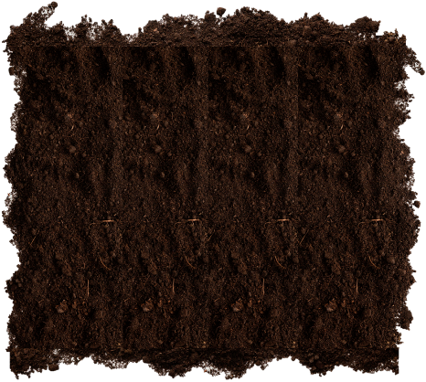
Row Intercropping - Example
The selection of plants for rows should take into account their mutual influence on each other (see companion planting).
Lettuce (Lactuca sativa)
Carrot (Daucus carota)
Onion (Allium cepa)

Slide 26
Strip intercropping
Strip intercropping involves planting crops in wider strips, with each strip consisting of a single crop. The strips are typically several rows wide, and the crops are arranged in such a way that they are grown in parallel strips across the field. This method is used on a larger scale compared to row intercropping and is designed to optimise the use of space while still taking advantage of the interactions between different crops. Strip intercropping allows for more efficient use of machinery for planting, cultivating, and harvesting.

Slide 27
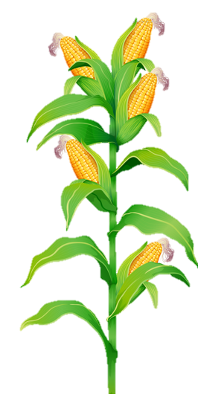
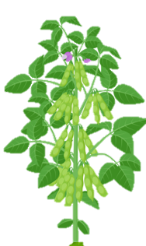
Strip Intercropping - Example
Soybean
(Glycine max)
Maize
(Zea mays)
and

Slide 28
Mixed Intercropping
Mixed intercropping involves growing two or more crops together in a random or semi-random mixture without a specific row arrangement. The crops are sown and grown together in the same area, creating a more integrated and complex planting system. This approach mimics natural ecosystems and can be highly effective in promoting biodiversity, reducing pest pressure, and enhancing resilience to environmental stress. However, it can make management practices like weeding, fertilising, and harvesting more challenging due to the lack of defined rows.

Slide 29
Mixed intercropping - Example
Mixed intercropping with grass and legume is one of the most common mixed intercropping and involves growing grass species alongside leguminous crops on the same piece of land, without a distinct row arrangement. This combination takes advantage of the complementary characteristics of both plant types, offering several ecological and agricultural benefits, particularly in improving soil health and increasing forage production and quality.
Example: Perennial ryegrass (Lolium perenne) and white clover (Trifolium repens)
Perennial ryegrass
grows quickly and establishes a dense mat of grass that helps suppress weeds and provide a reliable forage base for livestock
White clover
enriches the soil with nitrogen - this improves the growth of both the clover and ryegrass, reducing the need for synthetic nitrogen fertilizers

Slide 30
Relay Cropping
Relay cropping is an agricultural technique where a second crop is planted into an existing first crop before it is harvested. This method maximizes land use by overlapping the growing periods of two crops, improving overall productivity. It allows for more efficient utilization of resources like sunlight, water, and soil nutrients. However, it requires careful management to balance the needs of both crops and minimize competition for resources.

Slide 31
Relay Cropping - Examples
1
3
WINTER BARLEY
SEP
OCT
NOV
DEC
JAN
FEB
MAR
APR
MAY
JUN
JUL
AUG
SEP
OCT
SOYBEAN
2
4
1
Winter barley (crop 1) planting; time: October/November; variety example: Bazooka (hybrid variety with high yields and early maturity, well-suited for intensive relay cropping systems), KWS Cassia or KWS Orwell.
Soybean (crop 2) planting; time: late May (2-3 weeks before barley harvest); variety example: ES Mentor or Sultana; planting method: inter-seed soybeans between winter barley rows (38-50 cm row spacing).
Winter barley (crop 1) harvest; harvesting time: mid to late June.
Soybean (crop 2) harvest; harvesting time: mid to late October.
2
3
4

Slide 32
Relay Cropping - Examples
1
3
WINTER WHEAT
SEP
OCT
NOV
DEC
JAN
FEB
MAR
APR
MAY
JUN
JUL
AUG
SEP
OCT
FABA BEAN
2
4
1
Winter wheat (crop 1) planting; time: October/November; variety example: Graham or RGT Saki
Faba bean (crop 2) planting; time: May/June; variety example: Fuego or Boxer (early maturing, high-yielding variety with good resistance to lodging)
Winter wheat (crop 1) harvest; harvesting time: July
Faba bean (crop 2) harvest; harvesting time: October
2
3
4

Slide 33
3
1
Relay Cropping - Examples
SPRING OATS
MAR
APR
MAY
JUN
JUL
AUG
SEPT
OCT
NOV
DEC
JAN
FEB
MAR
APR
MUSTARD
2
4
1
Spring oats (crop 1) planting; time: March/April; variety example: Husky or Canyon
Mustard (crop 2) planting; time: July; variety example: Caliente 199 or IdaGold (early maturing, high-yielding variety with good resistance to lodging)
Spring oats (crop 1) harvest; harvesting time: July
Mustard (crop 2) harvest; harvesting time: October
2
3
4

Slide 34
Relay Cropping - Examples
1
3
RAPESEED
AUG
SEP
OCT
NOV
DEC
JAN
FEB
MAR
APR
MAY
JUN
JUL
AUG
OCT
FIELD PEAS
2
4
1
Rapeseed (crop 1) planting; time: late August to early September; variety example: InVigor L234PC or DK Exclaim (an open-pollinated variety with good yield potential and strong winter hardiness)
Field peas (crop 2) planting; time: May/June (just before rapeseed harvest); variety example: Arvika or CDC Amarillo (ideal for late-season planting)
Rapeseed (crop 1) harvest; harvesting time: May/June
Field peas (crop 2) harvest; harvesting time: October/November
2
3
4

Slide 35
Alley Cropping
Alley cropping is an agroforestry practice where rows of trees or shrubs are planted alongside crops in the same field. The trees provide benefits such as windbreaks, improved soil fertility, and habitat for beneficial insects, while the crops grow in the alleys between the tree rows. This system enhances biodiversity and can lead to increased overall productivity by optimising land use and resource sharing.

Slide 36
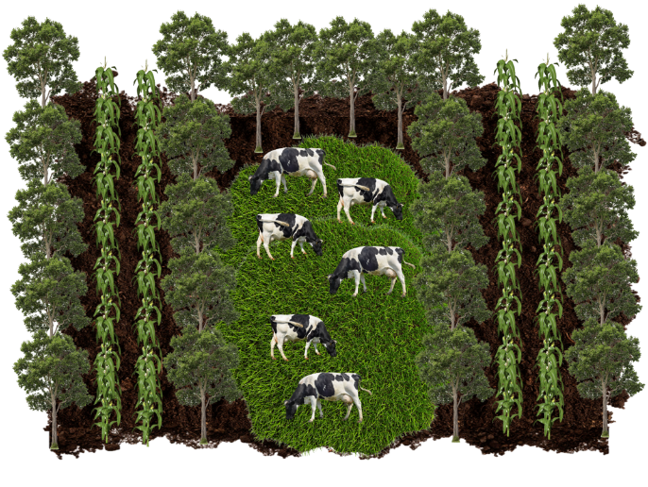
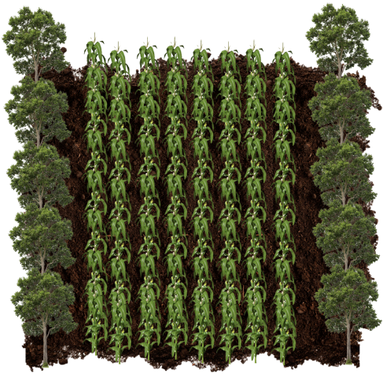
Scheme of Alley Cropping
alley crop
tree row
tree row
pasture
alley crop

Slide 37
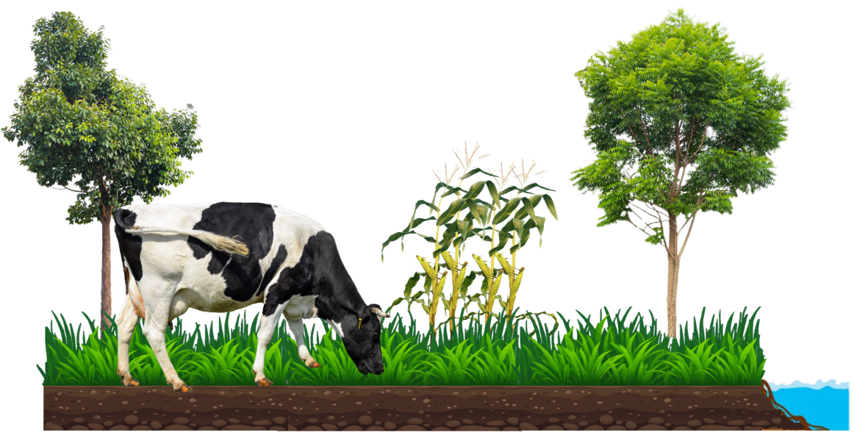
Alley Cropping - Benefits
create microclimate
buffer crops and livestock against extreme weather – provide shadow, reduce wind speeds
slow run-off
improve soil health and reduce its erosion

Slide 38
Companion Cropping
Companion cropping, also known as companion planting, involves growing two or more plant species in close proximity to each other for mutual benefit. This agricultural practice is used to enhance crop productivity, improve pest and disease control, and optimise resource use. Certain plants can attract beneficial insects, repel pests, or provide physical support to their companions, reducing the need for chemical inputs.

Slide 39
Companion Cropping - Examples
BEANS, CARROTS, GARLIC, CUCUMBER, LETTUCE,
ONION, ROSEMARY, SPINACH, DILL, SWISS CHARD, SAGE, THYME
PEPPERS, SQUASH, STRAWBERRY, TOMATOES
BEANS, CUCUMBER, DILL, MELON, PARSLEY, PEAS, SQUASH, SUNFLOWER
TOMATOES
BROCCOLI
CORN
BROCCOLI, CARROTS, CUCUMBER, CORN, TOMATOES, ROSEMARY, PEAS, STRAWBERRY, SWISS CHARD
BEANS, BROCCOLI, CAULIFLOWER, CORN, DILL, LETTUCE, NASTURIUM, ONION, PEAS, PEPPER, TOMATOES
CHIVES, GARLIC, LEEKS, ONION, PEPPERS, MARIGOLD
SAGE
BEANS
CUCUMBER
BEANS, BROCCOLI, CAULIFLOWER, CHIVES, LETTUCE, LEEKS
ONION, PEAS, PARSLEY, ROSEMARY, PEPPERS, SAGE
BASIL, BEANS, CHIEVES, CUCUMBER, GARLIC, LETTUCE, MARIGOLD, NASTURIUM, ONION, PARSLEY, PEPPERS
DILL
BROCCOLI, CAULIFLOWER, CORN, DILL
CARROT
TOMATO

Slide 40
Companion Cropping - Examples
BROCCOLI, CARROT, CUCUMBER, DILL, LEEKS, LETTUCE, PARSLEY, STRAWBERRY, SWISS CHARD, TOMATO
BROCCOLI, CAULIFLOWER, LETTUCE, STRAWBERRY, TOMATO
BEANS, PEAS
BEANS, PEAS
ONION
GARLIC
BROCCOLI, CARROT, CAULIFLOWER, CUCUMBER, DILL, GARLIC, ONION, SPINACH, SQUASH, STRAWBERRY, TOMATO
CARROT, ONION, SPINACH
BEANS, PEAS
LETTUCE
LEEK
BASIL, CARROT, CUCUMBER, OREGANO, PARSLEY, PEAS, SQUASH, SWISS CHARD, TOMATO
CORN, BEANS, LETTUCE, MELON, PEAS, PEPPERS, TOMOATO
GARLIC, BEET, BROCCOLI, CAULIFLOWER, FENNEL, ONION
BEANS, BROCCOLI, CAULIFLOWER
PEPPER
ZUCCHINI

Slide 41
04
Crop Succession and Rotation

Slide 42
Crop Succession
Crop Succession - practice of planning and implementing the order in which different crops are grown on the same land over a set period of time, typically within a crop rotation system. It is very important to know the requirements of individual plant species and the conditions they leave behind for the successor plant.

Slide 43
Crop Succession
Factors ensuring proper development and favourable environmental conditions for the successor plant:
sowing and harvesting of crops;
shading of the soil surface by plants;
water requirements;
preceding plant and disease or pathogens transmission;
nutritional and fertiliser requirements of plants;
the impact of crop plants on weed infestation;
the importance of crop residues;
dependence of changes on climate and soil.

Slide 44
Crop Succession - Sowing and Harvesting of Crops
early potatoes
winter rye or wheat
late potatoes
When planning crop rotation, it is important to select successive crops in the main yield so that their growing seasons do not overlap. There must be enough time between harvesting one crop and sowing the next to prepare the soil and plant at the optimal time. For example, after harvesting early potatoes, there is sufficient time to prepare the soil for sowing winter rye or wheat, whereas after late potato harvests, sowing rye becomes impossible.

Slide 45
Crop Succession - Sowing and Harvesting of Crops
In a rational crop rotation, winter or stubble cover crops are often grown after early-harvested crop. Cover crops should be sown as soon as possible after harvesting the main crop.
Cover crops can be used as green manure or animal feed. By plowing under the catch crop, the soil is enriched with organic matter, from which nutrients are released after mineralization.
Winter cover crops are sown when a spring crop is planned for the following year.
Stubble cover crops are sown when a winter crop is planned.

Slide 46
Crop Succession - Sowing and Harvesting of Crops
Cover crops are classified into the six groups. It is recommended to sow the plants as cover crops in the form of a mixture consisting of at least two plant species from different groups.
CEREALS
OILSEEDS
FORAGE CROPS
SMALL-SEEDED LEGUMES
LARGE-SEEDED LEGUMES
NECTARIFEROUS PLANTS

Slide 47
Crop Succession - Sowing and Harvesting of Crops
It is important to include leguminous plants in catch crops, as they have the ability to fix atmospheric nitrogen. Most common leguminous plants are:
HORSEBEAN
FIELD PEA
YELLOW LUPIN
COMMON VETCH
BLUE LUPIN
SERADELA
FACELIA
RED CLOVER

Slide 48
Sustainable Crop Management Practices – Crop Succession
Crop succession plan- due to the so-called soil fatigue, plant succession should be planned so that individual plant species do not occur more frequently in the same field than
perennial legumes – 4-6 years
flax -6-7 years
rapeseed – 3-4 years
beetroot – 3 years
legumes – 3 years
potatoes – 3 years
barley, wheat – 2 years

Slide 49
Crop Succession - Sowing and Harvesting of Crops
spring barley
red clover
Legume intercrops, such as red clover sown in spring barley or serradella sown in winter rye in the spring, play a significant role in crop rotation. The sowing of these plants should be early enough to ensure good germination and protect them from spring frosts. In the main crop, it is important to choose plant varieties that are intended for early harvest, as this creates favorable conditions for the development of intercrops.

Slide 50
Crop Succession – Water Requirement
The water requirements of plants play a crucial role in planning crop rotation. When designing a rotation system, it's important to consider the varying water needs of different crops to optimise soil moisture and avoid excessive depletion of water resources. Additionally, proper crop sequencing helps in managing water efficiently, ensuring that water-intensive crops are planted during periods of adequate rainfall or when irrigation is available, thereby enhancing overall crop performance and sustainability.

Slide 51
Crop Succession – Water Requirement
Water requirements are determined by the transpiration coefficient (TC) expressed in litres per kilogram of dry matter of biomass.
Plants with low TC (200-400)
sugar beet
sorghum
millet
Plants with moderate TC (400-700)
cereals
sunflower
large-seeded legumes
Plants with high TC (700-900)
flax
grasses
small-seeded legumes

Slide 52
Crop Succession – Water Requirement
Winter cereals and winter rapeseed are less sensitive to drought than spring cereals.
The most drought-resistant crop is winter rye, which has the most well-developed root system of all cereals. Winter wheat, on the other hand, is the most susceptible to drought among winter varietes. Oats are particularly susceptible to drought due to their high water requirements and inefficient water use. The most drought-resistant spring cereal is barley. The highest water demand for cereals occurs during the stages of stem elongation, heading, and grain development.
winter rye
oats

Slide 53
Crop Succession – Nutritional and Fertilizer Requirements of Plants
In agroecology, the goal is to recycle nutrients as much as possible within the farming system, minimising the need for external inputs. This approach not only reduces reliance on synthetic fertilisers but also helps to maintain a healthy soil ecosystem, improve water retention, and reduce erosion.
Natural fertilisers such as manure
apply to crops grown in wide rows, such as root crops (beets, potatoes) and corn.
In the year following manure application
cereal grains and legumes for seed production should be cultivated.

Slide 54
Crop Succession – The importance of Crop Residues
The most crop residues after harvest are left by perennial forage crops such as clover, alfalfa, grasses, and legume-grass mixtures, followed by cereals, with root crops leaving the least.
Clover with grasses
5,5 t of DM/ha
Winter Rapeseed
4,2 t of DM/ha
Spring Wheat & Rye
3,5 t of DM/ha
Spring Barley 2,5 t of DM/ha
Oats
3,7 t of DM/ha
Maize
20 of DM/ha

Slide 55
Crop Succession – The Importance of Crop Residues
Plants that leave the soil in good condition –
perennial legumes, such as clover, alfalfa, and their mixtures with grasses
The nutrients found in crop residues should be considered throughout the entire crop rotation. These residues significantly influence soil structure, with the effect being stronger when more plant mass with a valuable chemical composition remains after harvest. In terms of their impact on soil structure, agricultural plants can be categorised into three groups:
Plants that do not degrade soil –
annual legumes
Plants that leave the soil in poorer condition –
annual non-legumes
In crop rotation, it is important to follow the principle of cultivating soil-structure-improving plants after several years of growing annual crops.

Slide 56
Crop Succession – Shading of the Soil Surface by Plants
A large leaf area:
Agricultural plants affect soil shading depending on the size of their above-ground parts, particularly their leaves. This is important when cultivating soils prone to erosion. Crops that shade the soil more effectively should precede economically important crops in the rotation.
provides shade
reduces the impact of raindrops on the soil, which can damage its structure, compact it, and cause silting
protects the soil from the drying effects of sunlight
prevents the formation of a soil crust
prevents the development of the most germinated weeds
prevent excessive water evaporation from the soil

Slide 57
Crop Succession – Preceding plant and Disease or Pathogens Transmission
Break Crop Effect
Allelopathic Effects
Host-Pathogen Relationships
Residue Management
Diversified Rotations
Disease-Resistant Varieties
Cover Crops
In agroecology, the choice of preceding crops in a rotation system significantly influences the potential transmission of diseases and pathogens to subsequent crops. This is because different plants can either suppress or exacerbate the presence of soil-borne pathogens and pests, affecting the health of the crops that follow. Various strategies in crop succession can be used to prevent disease and pathogen transmission.

Slide 58
Break Crop Effect
Certain crops, known as break crops, can reduce the buildup of specific pathogens in the soil. For instance, non-cereal crops, such as legumes, oilseeds, or other broadleaf crops, in a crop rotation with cereals like wheat or barley. For instance, non-cereal crops, such as legumes, oilseeds, or other broadleaf crops, are not hosts for pathogens like Gaeumannomyces tritici, which causes take-all in cereals. Including these crops in rotation disrupts the life cycle of the pathogen, reducing its population in the soil.

Slide 59
Allelopathic Effects
Allelopathic effects play a crucial role in the prevention of diseases and pathogens in crop succession by releasing allelochemicals into the soil that have antimicrobial properties, effectively reducing populations of soil-borne pathogens. These chemicals can inhibit the growth and activity of fungi, bacteria, and nematodes that cause diseases in subsequent crops.

Slide 60
Examples of Allelopathic Effect of Plants in Crop Succession
Brassica species (e.g. mustard, canola) release glucosinolates that break down into isothiocyanates known for their biofumigant properties. Growing these as cover crops can reduce soil-borne diseases like clubroot and root rot in subsequent crops.
Leguminous (e.g., alfalfa, clovers) release allelopathic compounds that can suppress fungal pathogens such as Rhizoctonia and Fusarium. Alfalfa has autotoxic properties so it is not recommended to seed alfalfa on alfalfa! (adequate stands can be obtained by waiting at least 3 to 4 weeks after tillage).
Sorghum bicolor - produces sorgoleone with herbicidal properties inhibiting the germination and growth of various weed species but also shows some activity against soil-borne pathogens. Incorporating sorghum into crop succession can help in reducing diseases like root rot.

Slide 61
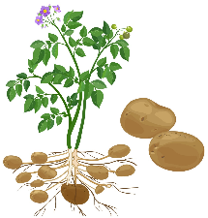
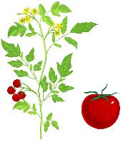
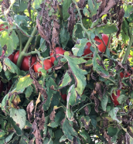
Host-Pathogen Relationships
If the preceding crop is susceptible to certain diseases or pests, these pathogens can survive in the soil or crop residues and infect the following crop if it belongs to the same family. For example, planting tomatoes after potatoes can increase the risk of soil-borne diseases like Verticillium wilt because both are susceptible to the same pathogen.
increase the risk of soil-borne diseases like Verticillium wilt

Slide 62
Agroecological Strategies for Residue Management
Physically removing residues (e.g. baling and removing straw) from the field can help reduce the amount of inoculum present.
Residue Removal
Tillage
Incorporating crop residues into the soil through tillage (not always applicable)
Residue Decomposition
Promoting rapid decomposition of residues (e.g. adding nitrogen fertilisers or using microbial inoculants can reduce the survival time of pathogens)
Residue Management
Crop residues, which include the remains of plants after harvest such as stems, leaves, and roots, can harbour pathogens and serve as a source of inoculum for diseases that affect subsequent crops. Proper management of these residues can significantly reduce the spread and severity of diseases in crop succession.

Slide 63
Agroecological Strategies for Disease-Resistant Varieties
Use of Disease-Resistant Varieties
Use of Local and Traditional Varieties
Using disease-resistant varieties is a key component of an agroecological approach to managing crop disease transmission during crop succession. This practice involves selecting crop varieties that have been bred or naturally possess resistance to specific pathogens. When integrated with other agroecological practices, disease-resistant varieties help reduce the spread of diseases, and promote a more sustainable and resilient agricultural system.
They often have natural resistance to diseases that are prevalent in specific regions.
Incorporating Resistant Varieties in Polycultures
Resistant varieties help limit the spread of pathogens between susceptible varieties, providing a protective effect in the field.

Slide 64
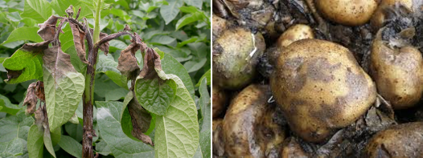
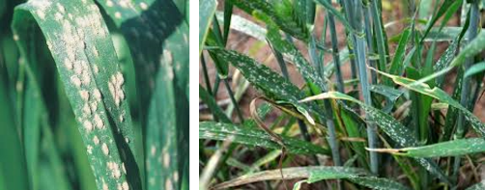
Examples of Disease-Resistant Varieties
Potato Late Blight (Phytophthora infestans)
Barley Powdery Mildew (Blumeria graminis)
Resistant Varieties: e.g. 'Sarpo Mira’, 'Bionica'
Using these varieties in rotation with non-solanaceous crops (e.g. cereals, legumes) reduces the pathogen's chances of surviving between growing seasons.
Resistant Varieties: e.g. 'Clipper' and 'Morex’
Planting these resistant varieties in rotation with non-cereal crops like clover or alfalfa can help reduce mildew spores in the field and avoid pathogen adaptation and resistance breakdown.

Slide 65
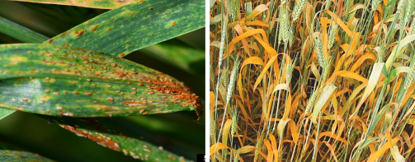
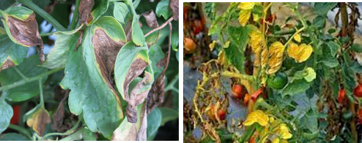
Examples of Disease-Resistant Varieties
Wheat Rust Diseases (Puccinia graminis)
Tomato Fusarium Wilt (Fusarium oxysporum)
Resistant Varieties: e.g. 'Lr34' and ‚Sr2 ’ ’
Integrating these resistant varieties into crop rotations with non-cereal crops (e.g., legumes) reduces rust inoculum in the field, lessening the disease pressure on subsequent wheat crops.
Resistant Varieties: e.g. 'Celebrity' and 'Better Boy'
These varieties can be planted in rotations that include crops not susceptible to Fusarium, such as corn or brassicas, which disrupt the pathogen's life cycle.

Slide 66
Agroecological Strategies for Cover Crop Managing Crop Diseases
Cover Crops
Disruption of Pathogen Life Cycles
Cover crops are an integral part of an agroecological approach to managing crop disease transmission during crop succession. They are non-cash crops grown primarily to protect and improve soil health, but they also play a crucial role in reducing the incidence of diseases in subsequent crops. By acting as a barrier to pathogens, improving soil structure, and fostering beneficial microbial communities, cover crops can effectively disrupt the life cycles of soil-borne pathogens and reduce disease pressure.
Many pathogens are host-specific and require a suitable host to survive and multiply.
Allelopathic Effects
Some cover crops release allelopathic compounds that can inhibit the growth of pathogens or reduce their viability.
Reduction of Splash Dispersal
Cover crops provide ground cover that reduces soil erosion and prevents the splash dispersal of soil-borne pathogens onto crop foliage, which is a common way diseases spread.

Slide 67
Crop Rotation
Crop rotation is an agricultural practice where different types of crops are planted in the same field in sequential seasons. This method helps maintain soil health, improve soil fertility, and reduce the buildup of pests and diseases associated with continuous monoculture. By rotating crops with different nutrient requirements and root structures, farmers can enhance soil structure, and minimise the need for chemical fertilisers and pesticides. Crop rotation is a fundamental strategy for sustainable farming.

Slide 68
Crop Rotation Practices
A legume crop (such as beans, lentils, peas, or soybeans) is grown in one season, followed by a cereal crop (like wheat, corn, or barley) in the next season.
This practice improves soil health by naturally fixing nitrogen and helps break pest and disease cycles, promoting higher yields for both crops.
LEGUME-CEREAL ROTATION

Slide 69
Crop Rotation Practices
Root crop-leafy crop rotation involves alternating root crops, like carrots or potatoes, with leafy crops, such as lettuce or spinach, to optimise soil nutrient use and reduce pest buildup.
This practice helps maintain soil structure, prevent soil depletion, and minimise the risk of diseases specific to either crop type.
ROOT CROP-LEAFY CROP ROTATION

Slide 70
Crop Rotation Practices
THREE-FIELD SYSTEM
Dividing the land into three sections and rotating between a cereal crop (wheat, barley), a nitrogen-fixing crop (soybean, alfalfa, and a fallow or cover crop (winter rye, clover) to maintain soil fertility and manage pests.

Slide 71
Common Crop Rotation Cycles
SIMPLE ROTATION - rotating between two types of crops, such as wheat one year and clover or fallow the next. This is often seen in less intensive farming systems.
THREE-YEAR ROTATION – e.g. rotating corn, soybeans, and wheat. This rotation helps manage different nutrient needs and pest cycles effectively.
FOUR-YEAR ROTATION – e.g. a cycle of corn, soybeans, wheat, and a cover crop such as alfalfa or clover. This adds a year of a legume or cover crop to replenish the soil.
EXTENDED ROTATIONS - more diverse crops and cover longer periods, such as a seven-year rotation including a range of vegetables, grains, and green manures.

Slide 72
Crop Rotation - Implementation
SOIL ASSESSMENT - to understand nutrient levels, pH, and soil texture to determine which crops are suitable and what amendments are needed.
CLIMATE CONSIDERATION - assessment of local climate conditions, including temperature, rainfall patterns, and growing season length to select crops that are well-suited to a specific climate.
PLANNING THE CROP ROTATION CYCLE - planning a sequence that rotates crops with different nutrient needs and pest resistance. Preparation of the soil and best practices for planting, including proper spacing, depth, and timing.

Slide 73
An example of a five-field crop rotation for better quality soil.
field 1
field 2
field 3
field 5
field 4
year 1
year 2
year 3
year 5
year 4
sugar beet
spring barley
field peas
winter wheat
winter canola
spring barley
field peas
winter wheat
winter canola
sugar beet
field peas
winter wheat
winter canola
spring barley
sugar beet
winter wheat
winter canola
field peas
sugar beet
spring barley
winter wheat
winter canola
sugar beet
spring barley
field peas

Slide 74
An example of a four-field crop rotation for soil of lower quality
field 1
field 2
field 3
field 4
potato
oat
blue lupin
rye
year 1
year 2
year 3
year 4
oat
blue lupin
potato
rye
blue lupin
potato
rye
oat
potato
rye
oat
blue lupin

Slide 75
05
Agroecological Practices for Nutrient Management on a Farm

Slide 76
Nutrient Management on a Farm
Agroecological practices for nutrient management on a farm are centered around creating a balanced, self-sustaining system that enhances soil fertility, promotes biodiversity, and minimises environmental impact. These practices aim to recycle nutrients within the farm ecosystem, reduce reliance on external inputs, and support healthy plant growth.

Slide 77
Agroecological Practices for Nutrient Management on a Farm
Cover Cropping and Crop Rotation
cover crops like clover, rye, or vetch between main crops, prevent soil erosion, add organic matter, and enhance nutrient cycling. Cover crops can be used as green manure by incorporating them into the soil. Incorporating a diversity of plant species, including legumes, helps maintain soil fertility, enriching the soil for subsequent crops.
Composting
compost made from farm waste, manure, and plant residues recycles nutrients within the farm system and improves soil structure and fertility.

Slide 78
Agroecological Practices for Nutrient Management on a Farm
Mulching
organic mulch such as straw, grass clippings, or leaf litter to the soil surface conserves moisture, reduces weed growth, and gradually adds organic matter as it decomposes.
Integrated Plant-Livestock Production
livestock integrated into the farming system provides a source of manure for organic fertilisation and contributes to nutrient cycling. Manure from grazing animals can be directly deposited onto fields, enriching the soil.
Nutrient Recycling
e.g. vermicomposting and biochar production recycle nutrients and enhance soil fertility and improve its structure and nutrient retention.

Slide 79
Fertiliser Requirements of Plants
The fertiliser requirements of plants are determined not only based on their nutritional needs but also on the nutrient content of the soil and how well different species can absorb these nutrients.
Excess nutrients can be leached from the topsoil (such as potassium, nitrogen, magnesium, sulfur) or released into the atmosphere (nitrogen), while a deficiency can reduce crop yields.

Slide 80
Nutrient Management on a Farm – Cover Crop and Crop Rotation
Plants with a positive impact on organic matter in the soil
Legumes
Perennial forage crops
Grasses
Soil fertility can be improved by cultivating crops in rotation that enrich the soil with organic matter, plowing under crop residues, growing cover crops, or applying natural fertilisers. Based on their impact on soil fertility, crops can be classified into three groups: plants with a positive, negative or neutral impact on organic matter in the soil

Slide 81
Nutrient Management on a Farm – Cover Crop and Crop Rotation
Plants with a negative impact on organic matter in the soil
Root crops
Maize
Root vegetables
The cultivation of these plants in wide rows, along with their late canopy closure and the cultivation practices between rows, accelerates the decomposition of humus and intensifies erosion processes. It is estimated that during the cultivation of these plants, approximately 1,0-1,5 t/ha of humus is mineralized. To prevent such losses of humus, it is recommended to apply about 15-16 t/ha of manure.

Slide 82
Nutrient Management on a Farm – Cover Crop and Crop Rotation
Cereals were previously considered to degrade the organic matter in the soil, but changes in their agronomic practices (such as increased canopy density due to shorter straw) and the use of combine harvesting have significantly increased the amount of crop residues plowed under and reduced their negative impact on the humus balance. However, it is important to note the lower quality of cereal residues due to their unfavourable carbon-to-nitrogen ratio.
Plants with a neutral impact on organic matter in the soil
Cereals
Grasses
Oilseeds

Slide 83
Nutrient Availability and Soil pH
In acidic soils, essential nutrients like P, Ca, and Mg become less available, while micronutrients like Fe, Mn, and Al can become more available
In alkaline soils, the availability of P, Fe, Mn, Zn, and Cu is often reduced.
Soil pH affects the solubility of nutrients and their availability to plants. Most crops thrive in soils with a pH range of 6.0 to 7.5. Soil pH influences the activity and composition of soil microorganisms, which are crucial for processes like nutrient cycling, organic matter decomposition, and nitrogen fixation.

Slide 84
Crops Tolerance Levels to Soil pH
rye: 4,0-6,5
potato: 4,0-6,5
triticale: 5,0-7,0
maize: 5,5-7,0
sugar beet: 6,0-7,5
rapeseed: 6,0-7,0
wheat: 6,0-7,5
barley: 6,0-7,5
Blueberries; 4,0-5,5
Soil pH affects root growth and function. In highly acidic soils, the availability of toxic elements like aluminum and manganese can hinder root development, while in alkaline soils, poor nutrient availability can limit root growth and efficiency. Different crops have varying tolerance levels to soil pH (see chart opposite).

Slide 85
Ranges of Liming Needs Depending on Soil Agronomic Class
The need for liming varies depending on the soil agronomic class, which is determined by factors such as soil texture, organic matter content, and initial pH levels. Ranges of liming needs depending on soil agronomic class are presented in below table:
Agronomic class of soil | pH ranges for liming
 | indispensable | needed | recommended | limited | redundant
Very light – sandy and loamy sands | <4,0 | 4,1-4,5 | 4,6-5,0 | 5,1-5,5 | >5,6
Light - sandy loams and loams | <4,5 | 4,6-5,0 | 5,1-5,5 | 5,6-6,0 | >6,1
Medium - clay loams | <5,0 | 5,1-5,5 | 5,6-6,0 | 6,1-6,5 | >6,6
Heavy – clays and heavy clays | <5,5 | 5,6-6,0 | 6,1-6,5 | 6,6-7,0 | >7,1

Slide 86
Organic Fertilisers
Unlike conventional farming, which often relies heavily on synthetic fertilisers, agroecology emphasizes the use of organic fertilisers such as compost, manure, and green manure. These natural fertilisers help improve soil structure, increase microbial activity, and enhance nutrient cycling. Agroecological practices also promote the use of cover crops and nitrogen-fixing plants (such as legumes) to naturally enrich the soil with essential nutrients like nitrogen, reducing the dependency on chemical inputs and fostering long-term soil health and sustainability.

Slide 87
Organic Fertilisers
Unlike conventional farming, which often relies heavily on synthetic fertilisers, agroecology emphasises the use of organic fertilisers such as compost, manure, and green manure. Below you can find some examples of organic fertilisers.
wood ash
sapropel
poultry litter
peat
compost
vermicompost
bone meal
dolomitic lime
green manure
manure

Slide 88
Well Done!!! You are doing great…keep going on this learning journey.
In Module 10 we present the important topic of Livestock Integration in Agroecology.

