Slide 1
MODULE 6
Water Resource Management
www.eu-dare.com

Slide 2
Self-Reflection
To assess your current knowledge please consider the following questions…
What is your understanding of how precision irrigation methods, such as drip irrigation, can enhance water efficiency in farming?
What are your views on the benefits and potential issues of using rainwater harvesting systems in agriculture?
Do you think knowing about soil water content and crop needs can influence irrigation and overall water management strategies?

Slide 3
Content overview
This module explores the critical aspects of water resource management in agriculture.
At the end of this module, you will understand the importance of managing agricultural water resources, identify factors affecting sustainable water management, and learn precision irrigation techniques like drip and sprinkler systems. You will also be able to evaluate the benefits of rainwater harvesting and the use of treated wastewater for irrigation.
01
Introduction
02
Precision Irrigation
03
Rainwater Use
04
Water-Smart Crop Selection
05
Wastewater Treatment

Slide 4
01
Introduction

Slide 5
Water resource management
Strategic planning, development, and efficient utilisation of water resources are essential in agriculture.
The extension of irrigated land is directly linked to water availability and infrastructure costs.
Understanding the state of irrigation infrastructure is crucial for assessing its impact on land use, energy generation, and economical operations.
Water-intensive agriculture is pivotal for high crop production and safeguarding water sources from contamination.
Read more here
Sustainable water management in agriculture under climate change

Slide 6
Water Management Strategy
1
Assessment of Multiple Aspects
2
Customised Strategies
3
Encouraging Water Utilisation

Slide 7
Water management strategy for Irrigation scheduling
Importance
Maximises agricultural production and conserves water resources.
Enhances the efficiency and long-term sustainability of irrigation systems.
Key Factors
Understanding the specific water needs of crops and the water-holding properties of the soil.
Implementing effective irrigation methods to ensure precise water application.
Leveraging the expertise of farmers to manage field-level irrigation practice

Slide 8
SOIL–CROP CHARACTERISTICS
soil – water storage capacity
infiltration rate
crop response to water
CLIMATE
evaporative demand
rainfall amount & distribution
temperature
Irrigation Scheduling
MANAGEMENT OBJECTIVES
technical support of the farmers by extension office experts
IRRIGATION PRACTICES
method of irrigation
water delivery systems
availability of water
Read more here
Crop evapotranspiration-Guidelines for computing crop water requirements

Slide 9
Soil water estimates and measurements
Crop stress parameters
Water in the soil directly regulates plant water status, influencing growth.
Soil Water Content: Quantified using techniques like Time Domain Reflectometry (TDR).
Soil Water Potential: Assessed using devices such as tensiometers, soil spectrometers, and pressure transducers
Use plant signals to determine irrigation timing, rather than soil measurements.
Useful when irrigation depths are predetermined and consistent.

Slide 10
Climatic parameters
Soil – water balance
Essential for local and regional irrigation programs.
Reference Evapotranspiration Estimated using weather data and empirical equations, with local calibration.
Crop Evapotranspiration Calculated using crop-specific coefficients.
Equilibrium between water in the soil and water entering/leaving.
Suitable for various agricultural settings, from small farms to regional systems.
High effectiveness, reliant on technological advancement and support services.

Slide 11
02
Precision Irrigation

Slide 12
Precision irrigation delivers moisture directly to crops in small amounts when required, accurately supporting crop needs.
The system ensures crops receive water and nutrients at the right time, place, and in optimal quantities, promoting their growth and development
Precision systems deliver water directly to the root zone, minimising waste and maximising utilisation.

Slide 13
Precision techniques tailor water application to individual crop needs and environmental factors, minimising wastage and maximising efficiency.
Sprinkler irrigation
Variable-Rate Irrigation (VRI)
Drip irrigation
Customised Water Application

Slide 14
Precision Irrigation Techniques
Sprinkler irrigation
Mimics natural rainfall by applying moisture from above
Ensures even moisture distribution throughout the field,
Variable-Rate Irrigation (VRI)
Manages watering cycles, adjusting water quantities based on specific field needs for optimised allocation.

Slide 15
Precision Irrigation Techniques
Drip irrigation
Delivers water directly to plant roots, ensuring optimal distribution and minimising runoff or evaporation losses.
Customised Water Application
Utilises weather forecasts and software algorithms to adjust irrigation operations dynamically in response to changing environmental conditions, enhancing water resource management.

Slide 16
BENEFITS
Reduced Excessive Water Use
Improved Productivity
Better Quality Yields
Helps with Environmental Policy Compliance
Reduced Manual Labour

Slide 17
03
Rainwater Use

Slide 18
RAINWATER HARVESTING involves collecting and storing rainwater for later use in agriculture.
Rainwater is collected from surfaces like roofs and stored in tanks, cisterns, or containers.
Storing rainwater addresses drought and water scarcity, showcasing the resilience of agricultural methods.
Enhancing agricultural development, particularly in regions facing water scarcity or unreliable rainfall pattern

Slide 19
Collection of surface runoff
Surface runoff collection is a prevalent form of rainwater harvesting.
Infiltration Systems
Infiltration systems collect rainwater from impermeable surfaces and let it seep into the ground below.
Types of rainwater harvesting
Rain Gardens
Rain gardens are shallow depressions filled with native plants and organic material used for rainwater collection.
Green Roofs
Green roofs involve planting vegetation on building rooftops to capture rainwater, preventing it from immediately flowing into nearby water bodies.
Rain Barrels
Rain barrels provide a convenient method for homeowners to gather rainwater from their rooftops.

Slide 20
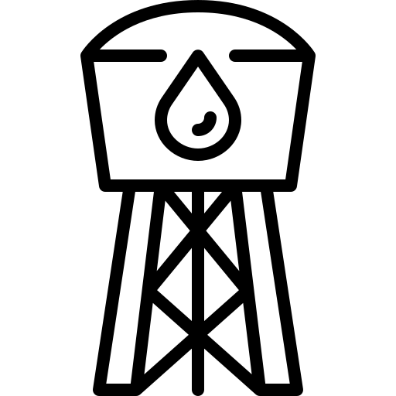
Benefits
Decreasing Reliance on External Sources
Abundance, Accessibility, and Low Salinity
Offering a supplementary and locally obtained water supply
Enabling the effective acquisition of this valuable resource
Cost-effective and eco-friendly tanks Systems
Read more here
Sustainable Water Management Practices for Intensified Agriculture
Demonstrating a pragmatic and environmentally aware alternative

Slide 21
04
Water-Smart Crop Selection

Slide 22
Water Smart Practices…
Implementing drought-resistant and indigenous crop cultivation promotes sustainable water use in agriculture.
Utilising crops with traits like extensive root systems and reduced transpiration aids adaptation to dry conditions.
Crop rotation improves resilience against drought and soil salinity, benefiting groundwater levels and agricultural output.
Techniques such as cover cropping and mulching help retain moisture and mitigate the impacts of water scarcity.

Slide 23
Key Elements of Water-Smart Crop Selection
Drought-Tolerant Varieties
Native Crop Planting
Crop Rotation
Choose crops with deep root systems and reduced moisture loss to thrive in water-scarce conditions.
Opt for indigenous crops adapted to regional climates for resilience against drought.
Employ crop rotation to enhance water efficiency and mitigate abiotic stresses like drought and soil salinity.

Slide 24
05
Wastewater Treatment

Slide 25
Waste Water Utilisation
Water Recycling
Integrated Planning
Use treated wastewater for irrigation to reduce dependence on limited freshwater resources.
Integrate planning and management in wastewater treatment for efficient water recycling and reduced environmental impact.
Read more here
Enhanced Resilience
Implementing agricultural wastewater reuse improves farmers' ability to withstand arid conditions and reduces adverse environmental effects
Use of Treated Sewage or wastewater as an Irrigation Water for Agricultural Purposes- Environmental, Health, and Economic Impacts

Slide 26
Key Elements of Water-Smart Crop Selection
Utilisation of Treated Wastewater
Purify water from various sources for agricultural irrigation, reducing reliance on freshwater resources and promoting sustainable water management.
Integrated Planning and Management
Integrate planning and management efforts for efficient wastewater treatment, considering water quality, environmental regulations, and crop requirements to ensure safety and health standards are met.
Cyclic Water Utilisation
Implement a closed-loop system where treated wastewater is used for irrigation, then collected for further treatment, enhancing water efficiency and reducing pollution.

Slide 27
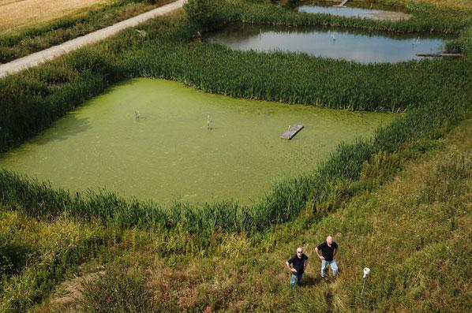
Be Inspired…
Ole Lyngby Pedersen and his brother Per helm I/S Faurgård, a pioneering third-generation farm nestled in Odder, central Denmark.
Joined forces with LIFE AGWAPLAN in 2008, transforming their farm into a beacon of innovation.
Ole's farm becomes a living laboratory for cutting-edge environmental techniques.
Witness the birth of Denmark's early artificial wetlands, marking a revolutionary leap in sustainable agriculture.

Slide 28
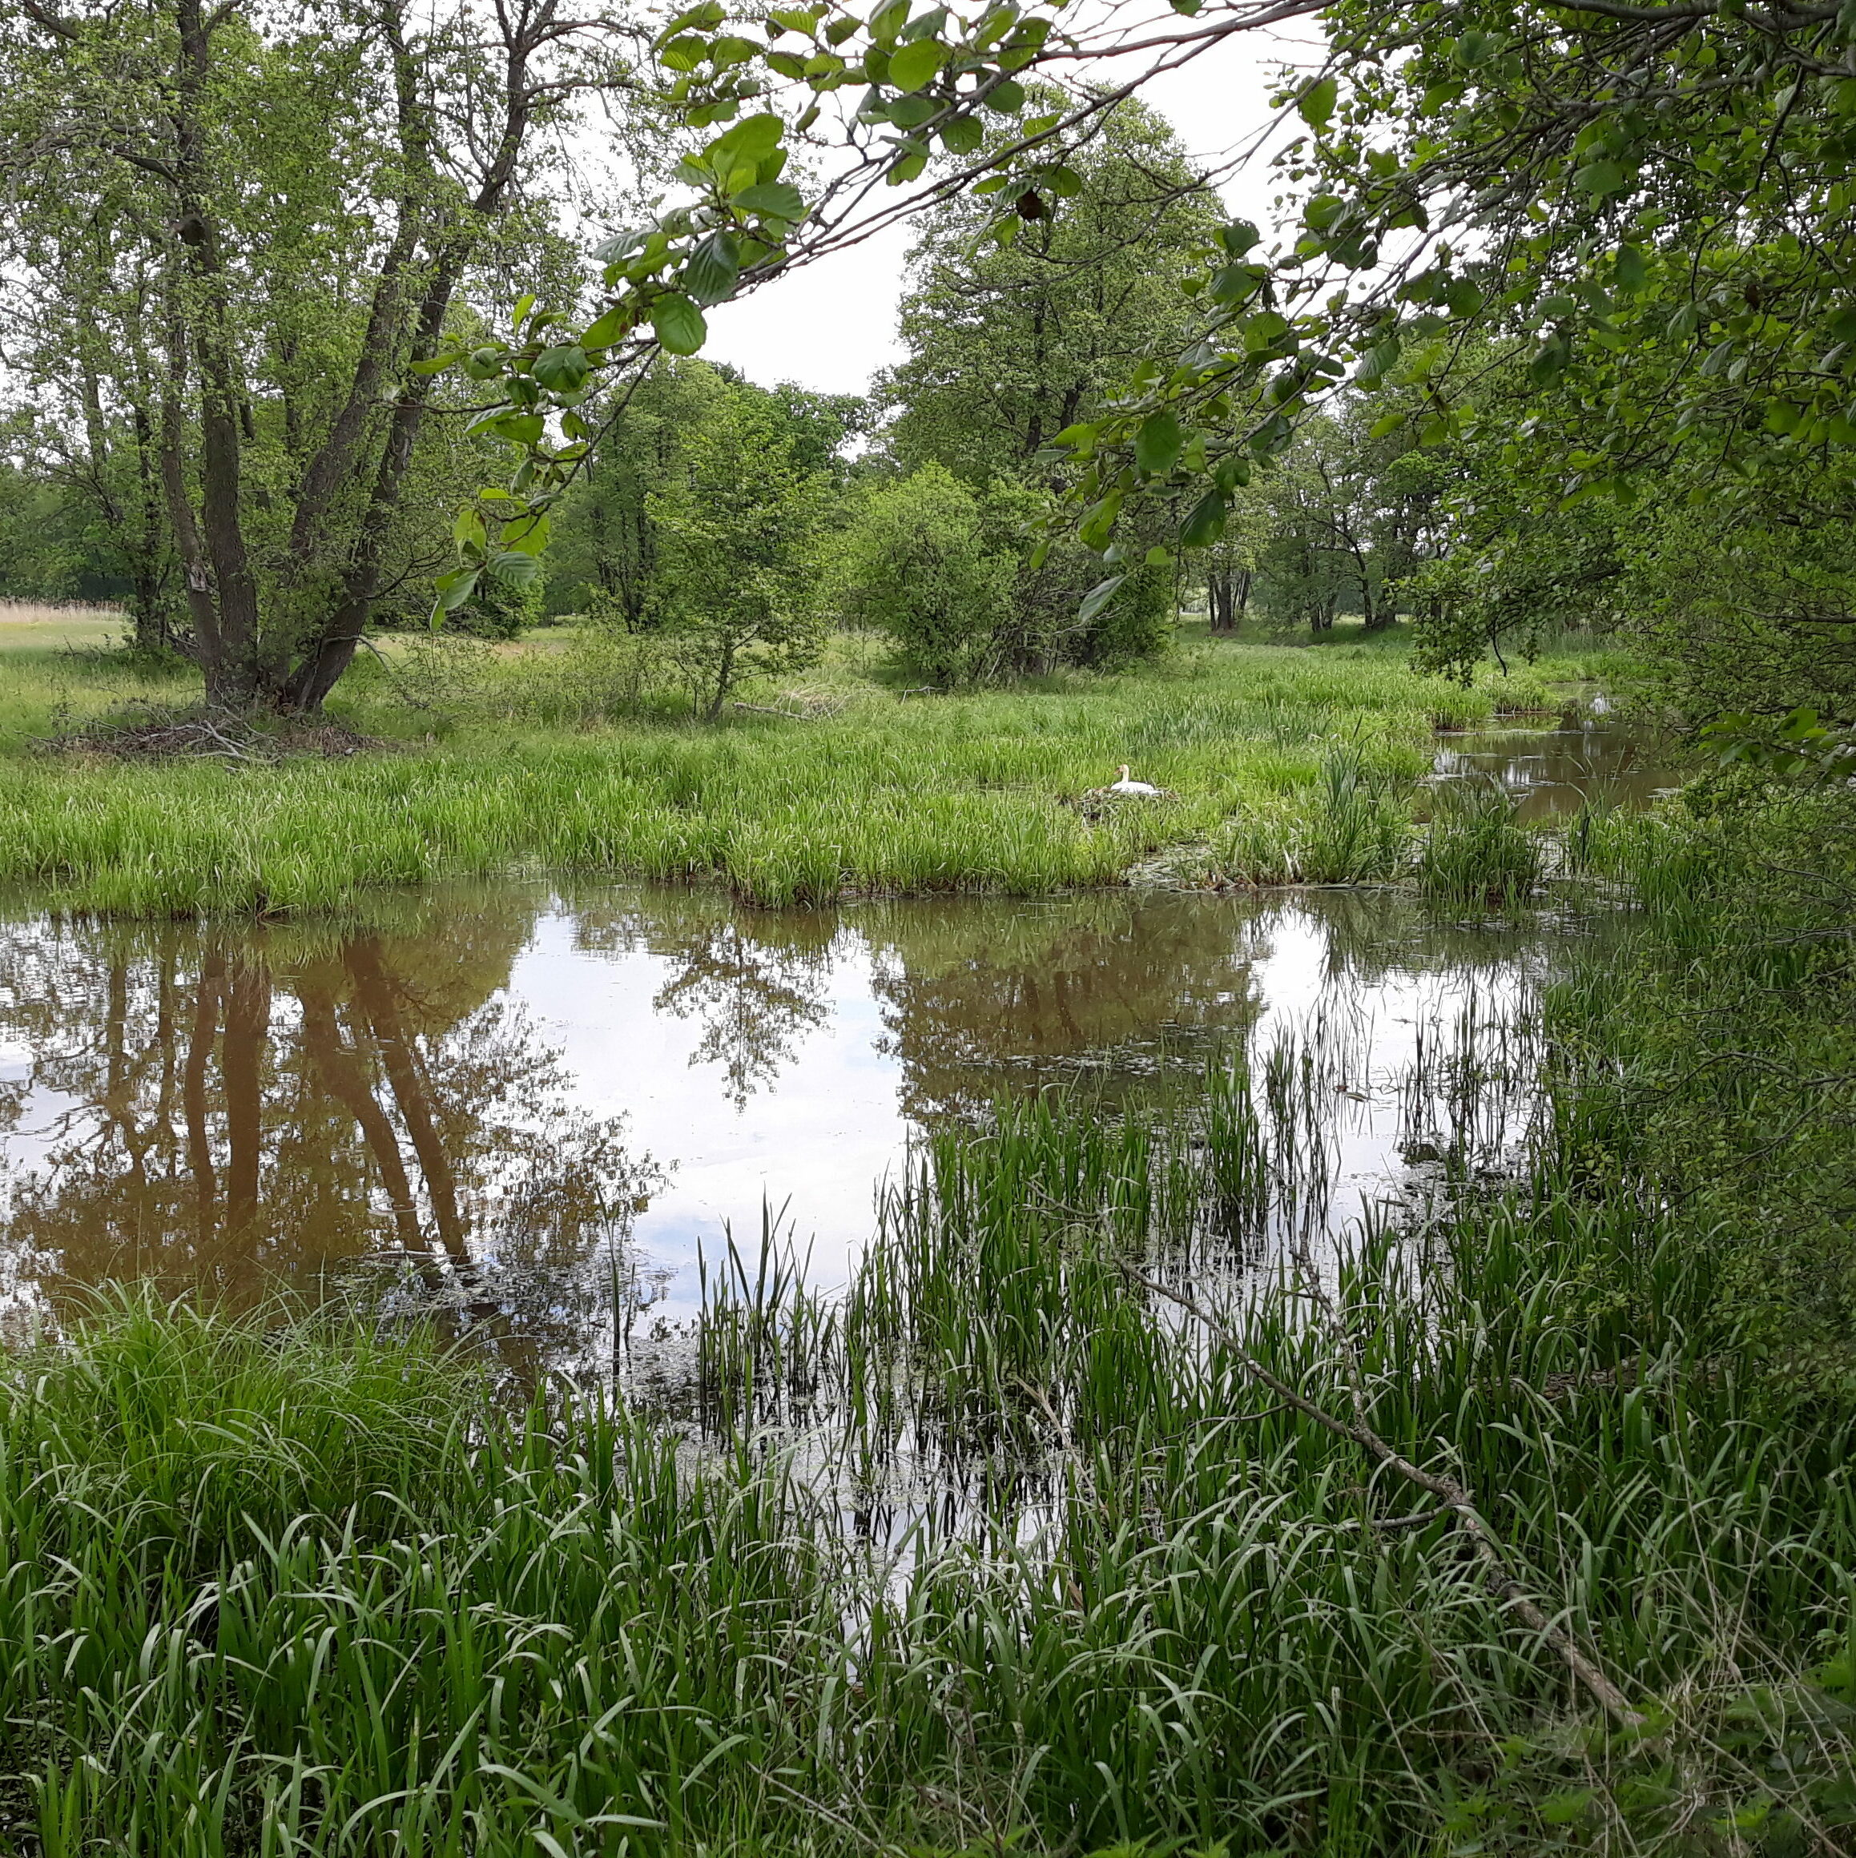
I/S Faurgård - continued
Ole uses a collection of sustainable practices like: precision fertiliser planning, strategic slurry management, and innovative buffer zones.
Ole's proactive approach, including property mapping and expert consultations, sets a new standard for environmental stewardship.
Hailed for his unwavering dedication and transformative impact, Ole's farm becomes a pilgrimage site for eco-conscious enthusiasts.
Read more here
The experimental farm that pioneered one of Denmark’s first constructed wetlands

Slide 29
Well Done!!! You are doing great…keep going on this learning journey.
In Module 7 we discuss Natural resource management focusing on Soil.

