Slide 1
MODULE 4
Impact of Agroecology on the Community
www.eu-dare.com

Slide 2
Content overview
Welcome to the module “Impact on the community”, where we will explore the impact of agroecology on food sovereignty and the local economy, with a focus on Community Supported Agriculture (CSA).
01
Introduction
02
Environmental Impacts and Food Sovereignty
Community Supported Agriculture (CSA)
03
Social Impacts and Empowerment
04
Economic Impacts on Communities

Slide 3
Learning outcomes
You will be able to discuss how the principles of agroecology and food sovereignty, promote environmental, economic and social sustainability in communities.
You will be able to interpret the importance & value of Community Supported Agriculture (CSA) as a model for achieving food sovereignty and its impact on community cohesion & well-being.
You will be able to compare the economic, social and environmental impacts of agroecology versus conventional agriculture, identifying the benefits and challenges in implementing agroecological practices in communities.
You will be able to demonstrate how to apply the concepts of agroecology and food sovereignty to develop community action plans that promote sustainable agricultural practices.

Slide 4
But first, let’s REFLECT
Please take a few minutes to reflect on the following questions:
What are some of the positive impacts that agroecology can have on communities?
Do you know of any practical tools that can foster food sovereignty among communities?

Slide 5
01
Introduction

Slide 6
Introduction
As a sustainable approach to agriculture, agroecology has a significant impact not only on the environment but also on the socioeconomic and political dynamics that shape agricultural production systems.
It results in greater autonomy and well-being for food producers, supports decent and meaningful forms of work within food systems and redefines interactions with non-human species and natural spaces.
As mentioned in module 3, the sociopolitical dimensions of agroecology include aspects such as the right to land, community seed banks, access to credit, local markets and knowledge sharing, work to build autonomous spaces that value local knowledge and transform food production into more ecologically sustainable and socially just systems.
Find out more:
Human and social values in agroecology

Slide 7
SDGs
1
Agroecology aligns with the UN Sustainable Development Goals (SDGs), providing a key response to drive the sustainable transformation of our food systems. It supports food producers in reducing production costs, which translates into higher income, economic stability and resilience.
Optimisation
2
By optimising the use of local and renewable resources and knowledge, agroecology enables agricultural production systems to harness the benefits of ecosystems, such as pest control, pollination, soil health and erosion control, while ensuring productivity.
Healthier
3
Furthermore, by minimising the use of potentially harmful agrochemical inputs, it reduces the negative effects of agriculture on human and environmental health and, by re-localising diets, can help inform sustainable and healthy diets.

Slide 8
"Sustainable agriculture is not just about growing crops, it's about caring for the soil, the water, the air, and all the living things that depend on them."
Vandana Shiva

Slide 9
For example Women play a central role in agroecology, often being custodians of healthy, traditional diets and key players in sustainable food systems, from the home to the field, to the market and beyond. Agroecology has the potential to advance women's rights, motivation and autonomy.
Agroecology is an approach that not only aims to produce food in a sustainable manner, but also acts as an engine of change and development for local communities, with a focus on youth, women and food sovereignty. This approach offers opportunities for a more just, inclusive and environmentally friendly agriculture while promoting food security, health and community well-being.
Find out more: Agroecology and the Sustainable Development Goals (SDGs)

Slide 10
02
Environmental Impacts & Food Sovereignty

Slide 11
Food sovereignty
Food sovereignty represents a social movement aimed at the empowerment of people, offering an alternative to the neoliberal vision of a world dominated by commodities and markets. This concept is a process adaptable to the specificities of people and places. Source
Food sovereignty emphasises solidarity rather than competition, aiming to build a more just and inclusive world. The term was coined in 1996 by La Via Campesina, a global movement of farmers, to describe a vision of a more equitable and sustainable food future. According to La Via Campesina…Food sovereignty implies the right of people to healthy and culturally appropriate food, produced in an ecologically sustainable way, and the right to define their own food and farming systems. Source

Slide 12
Food sovereignty is different from food security in both approach and politics. Food security does not distinguish where food comes from, or the conditions under which it is produced and distributed. National food security targets are often met by sourcing food produced under environmentally destructive and exploitative conditions, and supported by subsidies and policies that destroy local food producers but benefit agribusiness corporations. Food sovereignty emphasises ecologically appropriate production, distribution and consumption, social-economic justice and local food systems as ways to tackle hunger and poverty and guarantee sustainable food security for all peoples.
FOOD SOVEREIGNTY Vs FOOD SECURITY “YOU CAN HAVE FOOD SECURITY IN A PRISON OR A DICTATORSHIP, BUT YOU CAN NEVER HAVE FOOD SOVEREIGNTY”
Source: Nyéléni Newsletter no. 13 [2]

Slide 13
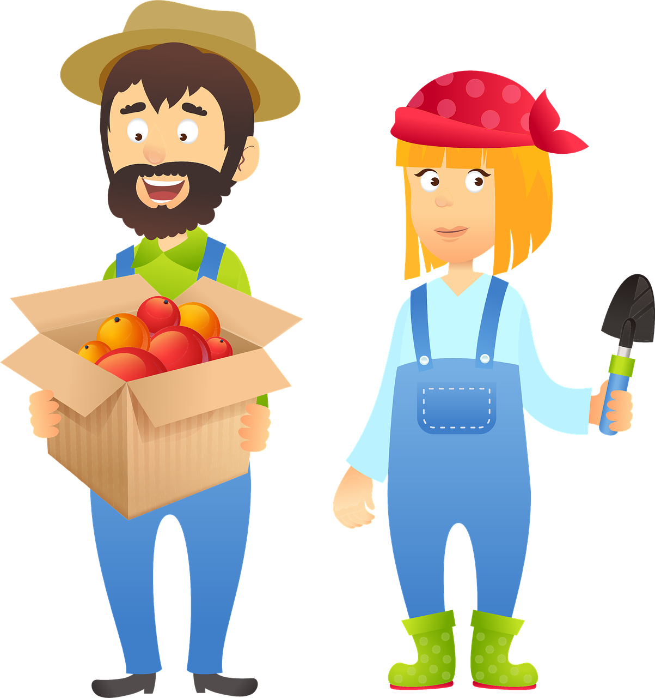
6 PILLARS OF FOOD SOVEREIGNTY
(Nyéléni Declaration)(Nyéléni Forum, Mali 2007)
Prioritising Food for People
Local Control of Food Systems:
This principle emphasises the right to adequate, healthy and culturally relevant food for all. It rejects the view of food as a mere commodity, promoting instead the view of food as a fundamental right.
Assigns control of resources such as land, water and seeds to local food producers, promoting the fair and sustainable use of these resources. It rejects the privatisation of these resources.
Valuing Food Producers:
Knowledge and Skills Development:
This pillar emphasises the importance of and respect for the rights of food producers, including farmers, fishermen and agricultural workers. It opposes policies and practices that devalue them or endanger their livelihoods.
Builds on the traditional knowledge of food producers and their local knowledge, promoting research and passing this knowledge on to future generations. It opposes technologies that compromise or contaminate local food systems.
Localised food systems
Harmony with Nature:
Promotes harmony & alignment between food producers and consumers, giving them a central role in food decisions. It opposes food dumping and the control of food systems by distant and unaccountable corporations.
Uses agro-ecological practices that optimise the contribution of ecosystems and improve resilience and adaptation to climate change. Rejects production methods that damage the environment and contribute to global warming.

Slide 14
Community Supported Agriculture (CSA), a tool for Food Sovereignty
CSA is a model that brings producers and consumers together, eliminating middlemen. In a CSA, final consumers support farmers by underwriting the harvest, usually one year, thus sharing the risks with the producer or a group of producers.
There is a complete bottom-up approach to food production. Producers have the ability to plan production based on subscriptions at a predetermined price. In this way, they do not run into the problems that arise with large-scale distribution that often leads to large quantities of unseen food, generating an economic loss for the producers.

Slide 15
The main idea of CSA is simple: a group of consumers get together with a farm in their vicinity. Together, they share the costs of the farming season, including land rent, seeds, tools and the farmers’ salaries. Likewise, they share the produce of the farm. This way: consumers get fresh food from a nearby farm, produced by farmers who they know; farmers get good working conditions and produce for people they know.
People must feel that the natural world is important and valuable and beautiful and wonderful and an amazement and a pleasure.
Sir David Attenborough

Slide 16
Trust as a key element of social relations in CSAs
CSAs are based on trust between consumers and producers. Trust is necessary for the creation of long-term business relationships and to ensure the sustainability of small-scale production.
The overlap of the two identities, that of consumer & producer, is another important aspect of the social relationship in CSAs.
Co-producers identify themselves as both consumers and producers.
CSAs are an alternative to the dominant food system, which is characterised by a clear division of roles and functions.
In CSAs, the relationship between consumers and producers is based on trust and collaboration
Firstly, co-producers pay for production in advance.
This shows their trust in the producer and their ability to deliver quality products.
In addition, co-producers participate in the life of the farm.
This allows them to get to know the producer and their work better, and to establish relationships of trust.

Slide 17
Steps for building a CSA
1
Find an agricultural producer
Start delivery
5
Once the CSA has reached a sufficient number of co-producers, deliveries can begin. Deliveries can be made at home, in a public place or at a collection point.
The first thing to do is to find an agricultural producer willing to cooperate with a CSA. The producer must be able to supply quality products in sufficient quantities to meet the needs of the co-producers.
2
Form a group of co-producers
Here are some tips for setting up a successful CSA:
Choose an agricultural producer who shares your values. It is important to find an agricultural producer who is committed to sustainable and quality food production.
Form a diverse group of co-producers. A CSA is stronger if it is composed of people of different ages, backgrounds and interests.
Be transparent and communicate with co-producers. It is important to keep co-producers informed about the activities of the CSA and the decisions that are made.
Once an agricultural producer has been found, a group of co-producers must be formed. The group should consist of people who are interested in supporting local agriculture and receiving fresh, quality produce.
3
Draw up a contract
The next step is to conclude a contract between the producer and the co-producer group. The contract should establish the terms of the collaboration, such as the quantity and quality of the products, the price, the frequency of deliveries and the responsibilities of each party.
4
Promote the CSA
Once the contract has been concluded, it is necessary to promote the CSA to attract new co-producers. Promotion can be done through different channels, such as social media, flyers or public events.

Slide 18
Conclusions
Food sovereignty is a fundamental right that allows communities to determine their own food and agricultural policies to ensure food security, nutrition, health and well-being.
CSAs are good models for food sovereignty because they enable consumers to play an active role in the production of the food they consume, promote local, sustainable and quality production, and help strengthen local communities.
In conclusion, CSAs are an important alternative to the dominant food system that can help promote a more just, sustainable and inclusive food system.

Slide 19
03
Social Impacts & Empowerment

Slide 20
Agroecology a source of empowerment: Agroecology projects involve collaboration between farmers and other community members, such as schools, non-governmental organisations and governments. This collaboration can help share resources and knowledge and build consensus for agroecology. Agricultural production can help people develop entrepreneurial skills, leadership skills and problem-solving skills. These skills can help people become more active members of their communities and improve their living conditions.
Economic development
Social inclusion
Environ-
mental protection
Agroecology can help create economic opportunities for community members. This can help reduce poverty and improve the quality of life.
Agroecology can help include marginalised groups in society. This can help create a more equal and inclusive society.
Agroecology can help protect the environment. This can help safeguard natural resources and reduce pollution.

Slide 21
Empowering Women
Women play a key role in agricultural production and food security but are often marginalised and have limited access to resources.
Agroecology can empower women in several ways, including by:
Improving their knowledge and skills: Agroecological practices, such as diversified crop management and integrated pest management, require a deeper understanding of agricultural principles and techniques. Training in agroecology can provide women with the knowledge and skills needed to become more effective farmers and better custodians of their land.
Strengthening their economic opportunities: Agroecology can increase women's incomes by promoting the production of high-value crops, expanding markets and improving access to fair and equitable prices. This can lead to greater economic independence and decision-making power for women in farming households.
Promoting gender equality: Agroecological practices, which emphasise collaboration, knowledge sharing and collective action, can foster a more equitable and inclusive environment for women in farming communities. This can lead to a reduction in gender-based discrimination and a more equitable distribution of resources and opportunities

Slide 22
Instil a sense of environmental stewardship
Educating & Engaging Youth
Agroecological principles emphasise the interconnectedness of human activities and the natural world. By involving young people in agroecological practices, we can instil a deeper understanding of environmental stewardship and encourage responsible resource management.
Promoting entrepreneurship and innovation
Agroecology offers a range of opportunities for young people to develop entrepreneurial skills and apply innovative solutions to agricultural challenges. By participating in agroecological projects, young people can gain practical experience, develop problem-solving skills and contribute to the sustainable development of their communities.
Strengthening food security and nutrition
Agroecological practices often focus on diversifying food production, which can improve household diets and contribute to better nutrition for young people and their families. This can have a long-term impact on health and well-being.

Slide 23
Social Impacts and Empowerment:
The Case of XFARM in Apulia
The XFARM cooperative, located in San Vito dei Normanni in the heart of Puglia, is an exceptional example of how agroecology can positively transform rural communities. Founding their operations on land once in the hands of organised crime, XFARM has created an ecological and social farm model that regenerates the ecosystem and generates significant social benefits.
Ecological and Social Regeneration
Through the transformation of 50 hectares into a multifunctional rural hub, XFARM promoted biodiversity and implemented circular economy practices. They reintegrated native plant varieties and organic and regenerative farming practices, improving soil fertility and eliminating environmental contamination.

Slide 24
Social Impacts and Empowerment:
The Case of XFARM in Apulia
Community Empowerment
XFARM has a strong commitment to labour integration, especially for people with difficulties in accessing the labour market, such as individuals with mental suffering or those coming from detention backgrounds. Agriculture thus becomes not only a means of producing food but also a tool for social and personal integration.
Education and Inclusion
With technical training programmes and support for scientific research, as well as initiatives such as summer camps and community events, XFARM encourages the active participation of the local community. The community garden and CSA (Community Supported Agriculture) activities allow community members to actively participate in agricultural production, strengthening the bond with the local area and among members themselves.

Slide 25
Social Impacts and Empowerment:
The Case of XFARM in Apulia
Development of Agroforestry Systems
The introduction of agroforestry prototypes and the conversion of an intensive olive grove into agroforestry systems demonstrate an innovative approach to agricultural resource management that integrates agricultural, forestry and livestock functions, contributing to a sustainable diversification of the Apulian agricultural landscape.
This case of XFARM clearly illustrates the wide range of positive impacts that agroecology can have on a rural community, highlighting how such practices not only improve the environment but also promote social cohesion, economic empowerment and social inclusion.

Slide 26
04
Economic Impacts on Communities

Slide 27
Improve Rural Communities Economy
Increased Income and Food Security:
Agroecology can enhance food production and improve food quality, leading to increased income for farmers
Diversified crop production and agroforestry practices can diversify income sources and reduce reliance on monocropping
Increased food production can enhance food security for households, particularly in marginalised communities

Slide 28
Improve rural communities economy
Reduced Costs and Improved Profitability:
Agroecology promotes natural pest and disease control, reducing the need for expensive external inputs
Integrated pest management (IPM) techniques can minimise pest damage and maximise crop yields
Reduced reliance on chemical fertilisers and pesticides can save farmers money and protect the environment

Slide 29
Enhanced Market Access & Value Chain Improvement:
Agroecology can produce high-quality, organic, and locally adapted produce, increasing market value
Community-supported agriculture (CSA) programs can connect farmers directly to consumers, bypassing middlemen and ensuring fair prices
Agroecology can promote fair trade practices and ensure equitable distribution of profits along the value chain

Slide 30
Job Creation & Diversified Economy:
Agroecology requires diverse skills and labour, leading to job creation in rural communities
The processing, packaging, and marketing of agroecological products can create additional employment opportunities
Agroecology can contribute to a more diversified rural economy, reducing reliance on a single crop or industry

Slide 31
Congratulations your learning journey is progressing so well…keep going!
In Module 5 we discuss & explore Landscape Ecology

