Slide 1
MODULE 5
Landscape Ecology
www.eu-dare.com

Slide 2
Content overview
In this module, we explore how nature works on the farm. We cover landscape ecology, which is about understanding the connections between plants, animals, and the land.
We look at practical tips for farmers like using water wisely, diverse crop planting, and taking care of the land. It's all about making farming work well with nature.
01
Introduction to Landscape Ecology
02
Characteristics of Landscapes
03
Key research topics
04
Landscape Components and Terms
05
Disturbance and Fragmentation
06
Practical Tips

Slide 3
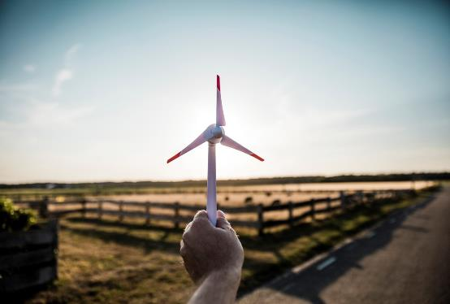
Learner Reflection
What is landscape ecology, and how do you think it can benefit farmers in their agricultural practices?

Slide 4
01
Introduction to Landscape Ecology

Slide 5
Introduction to Landscape Ecology
Landscape ecology dives into the fascinating web of nature's interactions in specific areas. Here's a closer look:
Definition: Imagine landscape ecology as the science of ecosystems, delving into how ecological processes and different ecosystems in an area relate and influence each other.
Scope: It's not just about the plants and animals; it's about the whole scene. Landscape ecology focuses on how the mix of living things and the land itself creates diverse and unique landscapes.
Interdisciplinary Nature: This field goes beyond traditional science. It blends the hard science of understanding ecosystems with a touch of humanities and complex perspectives. It's like connecting the dots between the physical environment and the human touch on nature's canvas.

Slide 6
Be Inspired…
Farma Blatnička, a Czech farm exemplifies sustainable farming practices. Established in 2010, the farm focuses on enhancing ecological resilience and biodiversity while mitigating the negative impacts of intensive agriculture. Key strategies include infiltration strips, tree alleys, biodiversity promotion, erosion control, and microclimate management.
Learn More
Obnova krajiny na Zálúčí u Blatničky | Adapterra Awards (youtube.com)

Slide 7
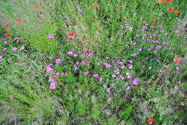
Example of landscape ecology - Farma Blatnička
Introduction: Example Description: In 2015, the farm's continuous monoculture was divided into smaller plots, promoting a mix of arable land, low-maintenance orchards, pear avenues, and copses. The introduction of grassy strips, meadows, and fallows increased biodiversity, creating a more ecologically balanced landscape.
Innovation Description:
Transformation: 65 hectares of monoculture to <10 hectares plots
Methods: Diverse farming techniques including arable land, orchards, grassy strips, and fallow fields
Goals: Increase ecological stability, improve climate change adaptation, reduce soil erosion
Today's Results:
Landscape: Ecologically stable and biodiversity-rich
Impact: Reduced erosion, improved soil conditions, better climate resilience
Diverse Farming: Supported natural soil life and ecological production
l

Slide 8
02
Characteristics of Landscapes

Slide 9
Characteristics of Landscapes
Spatial Heterogeneity: In the farming world, landscapes are like diverse tapestries. Spatial heterogeneity is about understanding how different parts of your land vary – from soil types to vegetation. It's the key to managing the unique patches of your farm effectively.
Emphasis on Pattern, Process, and Scales: Take a step back, and your farm tells a tale. Landscape ecology emphasises grasping the patterns of ecosystems, the processes shaping them, and the various scales at which these changes occur. It's about reading the dynamic narrative of your farm's ecology on a larger scale.
Coupling Biophysical and Socioeconomic Sciences: Farming isn't just about nature; it's a dance between natural forces and human actions. This characteristic recognises the intricate interplay between environmental factors and the decisions you make on the farm. It's understanding how your practices align with both the land and the needs of your community. Source

Slide 10
Examples
Spatial Heterogeneity: In a forest ecosystem, spatial heterogeneity can be observed in the patchy distribution of different tree species. For instance, certain areas might be dominated by pine trees, while other patches are dominated by oaks or maples. This distribution might be influenced by factors such as soil type, moisture levels, sunlight availability, and disturbances like fire or windthrow. The variation in these environmental factors creates a mosaic of different habitats, each supporting different communities of plants and animals.
Emphasis on Pattern, Process, and Scales: Consider a river system with a network of tributaries. The pattern might be the dendritic (branch-like) arrangement of the waterways. The process could include the hydrological cycle, sediment transport, and erosion that shape the river's form over time. The scales could range from the small-scale ripples on the water's surface to the large-scale watershed dynamics that influence regional water availability and ecosystem health.

Slide 11
Examples
Coupling Biophysical and Socioeconomic Sciences: Coastal zone management is an area where coupling biophysical and socioeconomic sciences is crucial. Biophysical sciences study coastal processes such as tidal movements, erosion, and habitat distribution. Socioeconomic sciences examine human activities like fishing, tourism, urban development, and policy-making. Effective coastal management strategies need to consider both the natural dynamics of coastal ecosystems and the socioeconomic demands placed upon them. For example, creating sustainable fisheries management plans involves understanding fish population dynamics (a biophysical concern) and the economic importance of fisheries to local communities (a socioeconomic concern).

Slide 12
03
Key Research Topics

Slide 13
Key Research Topics
Landscape Conservation and Sustainability
Role of Human Impacts on Landscape Diversity
Ecological Flows in Landscape Mosaics
Land Use and Land Cover Change

Slide 14
1. Ecological Flows in Landscape Mosaics
Exploring Ecological Flows: Envision your agricultural landscape as a living mosaic and try to delve into the nuanced dynamics of ecological flows, intricately connecting contrasting facets of your farm.
A Symphony of Interconnections: From the meandering paths of water to the designated corridors for wildlife, ecological flows are the intricate threads weaving through the fabric of your farm's mosaic. This exploration aims to comprehend the interconnected pathways that sustain biodiversity, nurture soil health, and establish a delicate equilibrium within your landscape.
Managing the Mosaic: Embark on a journey to comprehend how the recognition and deliberate management of ecological flows can optimize your farm's resilience and productivity. This involves harnessing the inherent rhythmic patterns of your landscape mosaic to cultivate a thriving and sustainable agricultural environment.

Slide 15
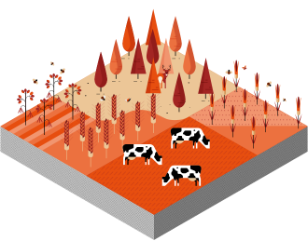
2. Land Use and Land Cover Change
Land Use and Land Cover Change refers to the transformation of Earth's surface over time, encompassing shifts in land utilisation patterns and alterations in natural or artificial features. This dynamic process is driven by a myriad of factors, including urbanisation, agriculture expansion, deforestation, and climate change. Understanding this topic is essential for informed environmental management, sustainable development, and the preservation of biodiversity.
Source
Source

Slide 16
3. Landscape Conservation and Sustainability
Ecosystem Integrity: Landscape conservation is the guardian of ecosystems, ensuring their structural and functional integrity endures. By safeguarding the delicate balance between plants, animals, and their environment, it provides a foundation for sustained productivity and ecological health.
Biodiversity Resilience: At its core, conservation efforts are a defense mechanism for biodiversity. Preserving diverse plant and animal species within the landscape not only nurtures the richness of nature but also fortifies the resilience of the entire ecosystem. Biodiversity acts as nature's insurance against environmental uncertainties.
Sustainable Resource Management: Sustainable landscapes are the product of conscientious resource management. Farmers, through conservation practices, play a pivotal role in optimising resource use—be it water, soil, or energy. This not only ensures the longevity of farming operations but contributes to the overall sustainability of the agricultural landscape.

Slide 17
4. Role of Human Impacts on Landscape Diversity
Shaping the Mosaic through Human Interactions
Land Use Practices: Human impact on landscape diversity is profound, often influenced by land use practices. Agricultural expansion, urbanisation, and deforestation reshape the physical makeup of landscapes, directly affecting the diversity of ecosystems and habitats.
Biodiversity Alterations: Human activities contribute to alterations in biodiversity patterns. The introduction of non-native species, habitat fragmentation, and overexploitation can disrupt the delicate balance of flora and fauna, leading to shifts in the composition of landscapes.
Ecosystem Service Modification: The choices humans make in land management impact the provision of ecosystem services. From altering water flow patterns to changing nutrient cycles, human actions directly modify the services landscapes offer, influencing the overall health and functionality of ecosystems.

Slide 18
04
Landscape Components & Terms

Slide 19
Landscape Components and Terms
Land Use Patterns: The arrangement of land use patterns paints a vivid picture of the landscape's functionality. From croplands to grazing pastures, these patterns impact ecological dynamics, resource distribution, and the overall resilience of the agricultural landscape.
Ecosystem Services Hub: The landscape acts as a central hub for a myriad of ecosystem services. From providing sustenance to regulating environmental conditions, recognising and enhancing these services is pivotal for sustainable land stewardship and agricultural productivity.
Waterways and Riparian Zones: Waterways etch their presence across the landscape, influencing its structure and health. Managing watercourses and protecting riparian zones are critical for biodiversity, water quality, and overall landscape resilience.

Slide 20
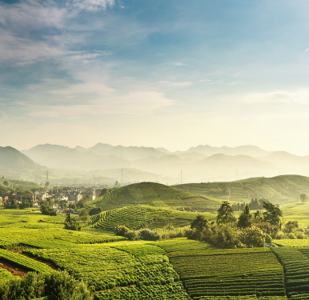
Landscape Components and Terms - continued
Green Infrastructure: Green infrastructure, the network of natural areas, serves as the lifeblood of agricultural ecosystems. Preserving forests, wetlands, and green spaces ensures the vitality and ecological balance within the landscape.
Edge Effects: The meeting points between different land uses, known as edges, create unique conditions influencing biodiversity and ecosystem dynamics. Understanding and managing these edge effects are important for sustainable and harmonious landscape management.

Slide 21
05
Disturbance & Fragmentation

Slide 22
Disturbance and Fragmentation
Ecosystem Disruption:
Disturbance, whether from natural events or human activities, can disrupt the delicate balance of ecosystems. Events like wildfires, floods, or intensive land use practices can lead to profound ecological changes, impacting biodiversity and ecosystem functions.
Fragmentation's Toll on Connectivity:
Landscape fragmentation, often driven by urbanisation or intensive agriculture, disrupts the natural connectivity between ecosystems. This can impede the movement of wildlife, limit genetic diversity, and undermine the ecological resilience of the landscape.
Source

Slide 23
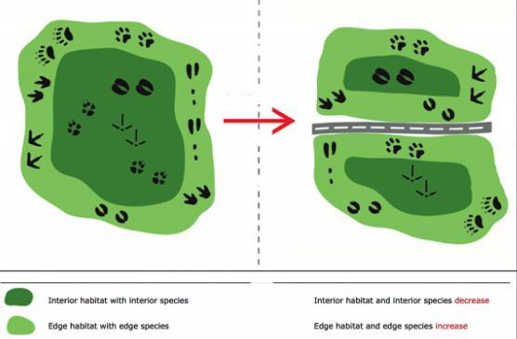
Disturbance and Fragmentation
Impact on Ecosystem Services:
Disturbance and fragmentation jeopardise the delivery of crucial ecosystem services. From pollination and water purification to climate regulation, these disruptions compromise the landscape's ability to provide essential services that support both agricultural and environmental sustainability.
Source
Interior habitat with interior species
Interior habitat and interior species decrease
Edge habitat with edge species
Edge habitat and edge species increase

Slide 24
06
Practical Tips

Slide 25
Practical Tips
1. Implementing Conservation Tillage
2. Diversifying Crop Rotation
3. Integrating Agroforestry Practices
4. Water Conservation Techniques
5. Cover Cropping Strategies
6. Precision Agriculture Technologies
7. Integrated Pest Management
8. Promoting Livestock Rotation
9. Adopting Climate-Smart Crop Varieties

Slide 26
Practical Tips
Implementing Conservation Tillage: Adopt conservation tillage practices to reduce soil disturbance and enhance soil structure. This approach minimises erosion, retains soil moisture, and promotes long-term soil health, contributing to sustainable and resilient farming.
Diversifying Crop Rotation: Embrace diverse crop rotations to enhance biodiversity, break pest cycles, and optimise nutrient use. Rotating crops promotes soil fertility, reduces the risk of diseases, and fosters a more balanced and sustainable agricultural system.
Integrating Agroforestry Practices: Integrate agroforestry by planting trees on the farm. This not only enhances landscape diversity but also provides additional benefits such as improved microclimates, carbon sequestration, and potential supplementary income through agroforestry products.

Slide 27
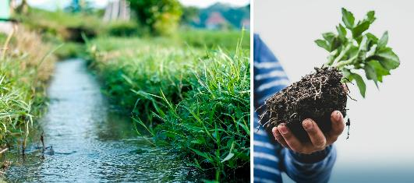
Practical Tips
Water Conservation Techniques: Implement water conservation techniques, including efficient irrigation practices and water recycling. Conserving water not only addresses resource scarcity but also contributes to sustainable agricultural production in the face of changing climate patterns.
Source

Slide 28
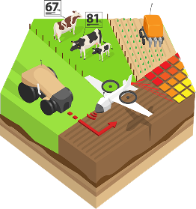
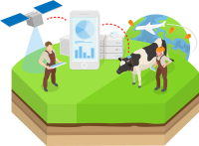
Practical Tips
Cover Cropping Strategies: Utilise cover crops during non-growing seasons to protect and enrich the soil. Cover crops prevent erosion, suppress weeds, and enhance soil fertility, promoting a healthier and more resilient agricultural landscape.
Precision Agriculture Technologies: Embrace precision agriculture technologies for optimised resource use. These tools enable accurate application of inputs, reducing wastage, minimising environmental impact, and enhancing the overall efficiency of farming operations.
Source

Slide 29
Practical Tips
Integrated Pest Management (IPM): Implement Integrated Pest Management (IPM) strategies to minimise reliance on chemical pesticides. By incorporating biological control methods, crop rotation, and pest-resistant varieties, farmers can foster a balanced ecosystem and reduce environmental risks.
Promoting Livestock Rotation: Practice rotational grazing and livestock rotation to prevent overgrazing and maintain healthy pastureland. This approach not only improves livestock health but also supports sustainable land management by preventing soil degradation.
Adopting Climate-Smart Crop Varieties: Choose climate-smart crop varieties that are adapted to changing environmental conditions. These varieties are resilient to climate extremes, ensuring consistent crop yields and contributing to long-term agricultural sustainability.

Slide 30
Further Reading…
Ellis EC, Gauthier N, Klein Goldewijk K, Bliege Bird R, Boivin N, Díaz S, Fuller DQ, Gill JL, Kaplan JO, Kingston N, Locke H, McMichael CNH, Ranco D, Rick TC, Shaw MR, Stephens L, Svenning JC, Watson JEM. People have shaped most of terrestrial nature for at least 12,000 years. Proc Natl Acad Sci U S A. 2021 Apr 27;118(17):e2023483118. doi: 10.1073/pnas.2023483118. PMID: 33875599; PMCID: PMC8092386.
Wiens JA (2005). "Toward a unified landscape ecology". In Wiens JA, Moss MR (eds.). Issues and perspectives in landscape ecology. Cambridge: Cambridge University Press.

Slide 31
Well Done!!! You are doing great…keep going on this learning journey.
In Module 6 we discuss Natural resource management focusing on Water.

