Slide 1
MODULE 3
Building Bridges between Agroecology & the Community
www.eu-dare.com

Slide 2
Content overview
01
Introduction
Welcome to the module “Building Bridges between Agroecology & the Community”, where we will discuss, explore and strengthen the connections between agroecological practices and community well-being & resilience.
02
Promoting community ties through agroecology
03
Strengthening of socio-economic dynamics
04
Support of food self-sufficiency & security
05
Strengthening social justice & inclusiveness

Slide 3
Learning Outcomes:
To equip students with the knowledge on how to integrate ecological principles into farming to provide sustainable and contextual solutions to local agricultural challenges, thereby promoting food security, nutrition, and social equity.
To emphasise the importance of collective efforts from all stakeholders, including farmers, caterers, businesses, and citizens, to foster a new way of thinking about food, agriculture, and the environment.
To allow communities to work towards building resilient local economies, supporting smallholder farmers, and ensuring access to nutritious and culturally appropriate food for all.
Notes:
AGATA project as Case study

Slide 4
SELF-REFLECTION
Please take a few minutes to reflect on the following questions:
After our introduction to agroecology in Module 1…What is now your current understanding of agroecology and how it differs from conventional agricultural practices?
Can you describe any existing initiatives in your community or elsewhere that promote agroecological practices and involve community participation?

Slide 5
01
Introduction

Slide 6
Introduction
The complex interplay between agroecology and community embodies a symbiotic relationship that transcends mere agricultural practices.
Agroecology is a holistic and integrated approach that aims to provide contextual solutions to local problems with people at the centre.
It is based on bottom-up practices and territorial processes that allow farmers to work with nature and develop their own solutions to problems.

Slide 7
Introduction
Achieving an agro-ecological future requires everyone, including farmers, caterers , businesses and citizens, to support a new way of thinking about food, agriculture and the environment.
By adopting agroecological practices, communities can work towards sustainable agriculture, food security and nutrition [Agroecological Approach to Farming for Sustainable Development: The Indian Scenario].
This new way of thinking promotes ecological balance, economic viability, and social equity, ensuring that agricultural practices contribute positively to the well-being of communities.
The 10 Elements of Agroecology
Read more here

Slide 8
Introduction
As communities embrace these principles, they can build stronger, more resilient local economies, support smallholder farmers, and ensure that everyone has access to nutritious and culturally appropriate food.
These practices include recycling nutrients, promoting biodiversity, reducing dependency on external inputs, and fostering resilience to climate change.
In essence, agroecology is a transformative approach that integrates ecological science with social equity, aiming to create a sustainable and just food system for all.
FAO’s Work on Agroecology
Read more here

Slide 9
02
Promoting Community ties through

Slide 10
Promoting community ties through agroecology
Agroecology serves as a catalyst for community cohesion and empowerment by fostering cooperative relationships between individuals involved in agricultural practices and community members.

Slide 11
The purpose of my work was never to destroy but always to create, to construct bridges, because we must live in the hope that humankind will draw together and that the better we understand each other the easier this will become.
Alphonse Mucha

Slide 12
Promoting community ties through agroecology
When adopting agroecological principles, communities often engage in processes of collective decision-making, knowledge sharing and participatory learning.
This collective approach builds a sense of ownership and shared responsibility and strengthens social bonds between community members. There are several effective ways to strengthen ties and promote cooperation:
Sharing experiences & know-how
Creating community gardens & projects
Education & Outreach
Community events and actions
Participation in local discussions & decision-making
Supporting local markets
Joint education & research projects
Read more in: UTTER, Alisha; WHITE, Alissa; MÉNDEZ, V. Ernesto a MORRIS, Katlyn. Co-creation of knowledge in agroecology. Online. Elementa: Science of the Anthropocene. 2021, roč. 9, č. 1. ISSN 2325-1026.

Slide 13
Promoting community ties through agroecology
Education and Outreach:
In France the Fermes d'Avenir initiative organises workshops and training sessions on sustainable farming practices, educating farmers and the public about agroecology.
They provide hands-on experiences and theoretical knowledge on topics such as permaculture, biodiversity, and soil health.
Read more at: www.fermesdavenir.org

Slide 14
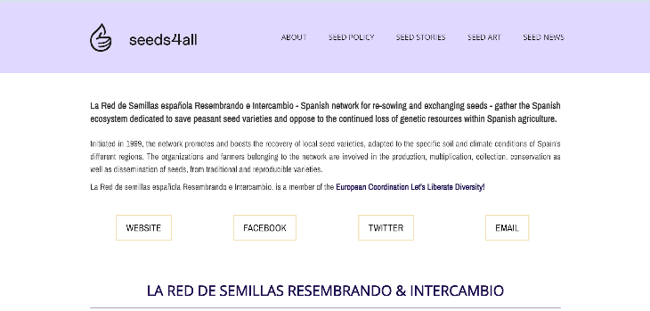
Promoting community ties through agroecology
Sharing Experiences and Know-How:
In Spain the "Red de Semillas" (Seed Network) facilitates the exchange of seeds and farming techniques among farmers and communities.
This network promotes agro-biodiversity and the preservation of traditional farming knowledge through regular meetings and events where participants share their experiences.
Read more at: www.seeds4all.eu/seed-operators/spain/red-de-semillas-resembrando-intercambio/

Slide 15
Promoting community ties through agroecology
Community Events and Actions:
In Italy, the "Campagna Amica" farmers' markets, organized by Coldiretti, promote local and sustainable food production.
These markets serve as community hubs where farmers and consumers can interact, learn about agroecological practices, and participate in workshops and tastings.
Read more at: www.campagnamica.it/world-farmers-markets-coalition/

Slide 16
Promoting community ties through agroecology
Community Events and Actions:
In Denmark, the "Food Council" in Copenhagen involves citizens, farmers, and policymakers in discussions about the city's food policies.
This participatory approach ensures that diverse perspectives are considered in the decision-making process, promoting sustainable and inclusive food systems.
Read more at: www.agricultureandfood.dk

Slide 17
03
Strengthening Socio-Economic Dynamics

Slide 18
Strengthening of socio-economic dynamics
Applying agroecological principles within communities often results in diverse, resilient agricultural systems that contribute significantly to local economies. There are several agroecological practices that can contribute to this:
Agrobiodiversity
Reducing the use of chemicals
Integrating trees into agricultural systems
Crop rotation and mixed cropping
Community gardens and collaboration
Joint education and research projects
Source: BONAUDO, T., BENDAHAN, A. B., SABATIER, R., RYSCHAWY, J., BELLON, S. et al. Agroecological principles for the redesign of integrated crop–livestock systems. Online. European Journal of Agronomy. 2014, roč. 57, s. 43-51. ISSN 11610301.

Slide 19
Strengthening of socio-economic dynamics
These agroecological principles not only contribute to the creation of more resilient agricultural systems but can also have a positive impact on local economies by promoting production diversification, reducing input costs, and improving soil and crop quality.
In this way, they can create a strong and sustainable agricultural environment that contributes to the overall prosperity of local communities.
Read more: Wagh, P., Singh, A., Singh, G., & Sasane, P. (2024). Agro-ecology: Integrating Ecology into Agricultural Systems. In Fields of Tomorrow: Advancements in Modern Agriculture. Astitva Prakashan.

Slide 20
Strengthening of socio-economic dynamics
By prioritising biodiversity, agroecology promotes sustainable land use and also increases the resilience of agricultural production to environmental challenges.
This resilience can protect communities from the risks associated with monoculture and industrial agriculture, contributing to food security and stability in local economies.
In addition, agroecology's emphasis on local production and consumption can stimulate economic growth by supporting small farmers and local markets, thereby strengthening the economic fabric of communities.
Read more: CHAUDHARY, Suraj; SHRESTHA, Atmaz Kumar; RAI, Sushil; ACHARYA, Dhana Krishna; SUBEDI, Sabnam et al. Agroecology integrates science, practice, movement, and future food systems. Online. Journal of Multidisciplinary Sciences. 2023, roč. 5, č. 2, s. 39-60. ISSN 26715449.

Slide 21
04
Support of Food Self-sufficiency

Slide 22
Support of food self-sufficiency & security
Agroecology plays a key role in promoting food self-sufficiency – a concept involving the right of communities to control their food systems – by enabling communities to produce diverse, nutritious food in a sustainable manner.
Through agroecological practices that prioritise agrobiodiversity and traditional knowledge, communities gain greater autonomy over their food production and consumption patterns.

Slide 23
Support of food self-sufficiency and security
This autonomy over their food production and consumption patterns ensures access to healthy and culturally relevant food while also reducing dependence on external markets and agribusiness corporations. Some of these procedures include:
Agrobiodiversity and cultivation of locally adapted crops
Seed bank conservation
Local communities and community gardens
Local production and consumption
Traditional knowledge and techniques
Community Harvesting and Exchange
Read more: Altieri, M. A., & Nicholls, C. I. (2021). Agroecology: A Brief Account of its Origins and Currents of Thought in Latin America. Agroecology and Sustainable Food Systems.

Slide 24
05
Strengthening Social Justice & Inclusiveness

Slide 25
Strengthening social justice and inclusiveness
Agroecology promotes the principles of social justice, equality, and inclusiveness within communities.
By promoting equitable access to resources, knowledge, and decision-making processes, agroecology empowers marginalised groups – such as women, indigenous communities, and smallholder farmers – to actively participate in shaping their food systems.
Read more: Project Regeneration

Slide 26
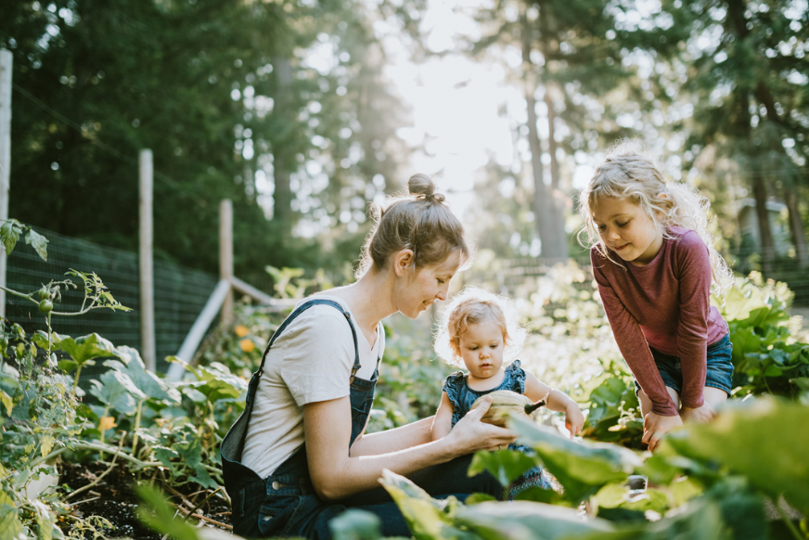
Strengthening social justice and inclusiveness
This inclusive approach recognises diverse knowledge systems and cultural practices, but also addresses social inequalities and promotes a fairer and more just society. Some specific activities that can be implemented to achieve this goal include:
Community Gardens
Farmers Markets
Involvement of youth and women
Knowledge sharing
Land ownership and access to resources
Fair trade and local markets
Community Seed Banks
Education and awareness raising
Participatory decision-making
Promoting family farming

Slide 27
Be Inspired…
Case Study 1
1
Community gardens in the capital city of Slovakia
Community Gardens in Bratislava
Case Study 2
2
Biofarma with its own shepherd’s hut
Biofarma.sk
Case Study 3
3
Educational and Research Initiatives
Center for Environmental and Ethical Education Živica

Slide 28
Super!!!
You have just completed Module 3…keep going on this learning journey.
In Module 4 we discuss the Impact of Agroecology on the Community.

