Slide 1
MODULE 2
Policies & Frameworks Associated with Agroecology
www.eu-dare.com

Slide 2
Policy & frameworks
In this module, we will discuss the existing EU & UN directives and strategies that govern, or are aligned with Agroecology and its practices. We also introduce some common labels and direct you towards relevant Associations in your country.
At the end of this module, you will have a better understanding of how well-aligned Agroecology is with these critical and potentially impactful policies and goals
01
European Directives and Strategies
02
The SDGs and Agroecology
03
Certification and Labels
04
Food & Agricultural Organisations

Slide 3
But first let’s REFLECT
What is your knowledge of the potential impacts of the European Union's Farm to Fork Strategy and the 2030 Biodiversity Strategy on local farming practices?
How do you think these policies support the transition to agroecology and contribute to achieving the Sustainable Development Goals (SDGs)?"

Slide 4
01
European Directives and Strategies

Slide 5
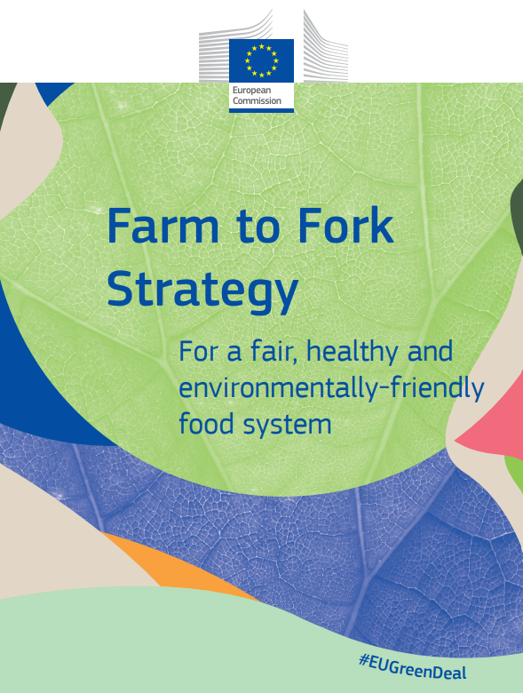
Agroecology and Europe
The European Union (EU) has been at the forefront of integrating sustainable practices in agriculture, with key policies like the Farm to Fork Strategy and the 2030 Biodiversity Strategy playing pivotal roles. Both of these strategies not only advocate for but also actively support the principles of Agroecology, helping to steer European agriculture towards a more sustainable, equitable and environmentally friendly future.

Slide 6
Launched as a part of the European Green Deal, the Farm to Fork Strategy aims to make food systems FAIR, HEALTHY, AND ENVIRONMENTALLY FRIENDLY.
It recognises the crucial role agriculture plays in managing natural resources & mitigating climate change.
The strategy supports Agroecology through:
Reducing Chemicals in Farming
1
It sets targets for reducing the use of pesticides, fertilisers, and antibiotics in farming, which aligns with agroecological principles of diminishing external chemical inputs.
Promoting Organic Farming
2
The strategy aims to increase the area of agricultural land under organic farming. This aligns with agroecology as organic farming relies on ecological processes and cycles.
Encouraging Sustainable Food Production
3
Farm to Fork focuses on sustainable food production and reducing the carbon footprint of the agriculture sector, both central principles of Agroecology

Slide 7
The 2030 Biodiversity Strategy is part of the EU's commitment to HALT BIODIVERSITY LOSS and build a healthy and resilient environment. It is intricately linked with agricultural practices, given the significant impact farming has on ecosystems.
The strategy supports Agroecology through:
Biodiversity Conservation
1
By aiming to protect 30% of the EU’s land and sea areas, it creates a conducive environment for agroecological practices that thrive on and contribute to biodiversity.
Restoring Ecosystems
2
The strategy includes plans to restore degraded ecosystems, including agricultural lands, which aligns with agroecological principles of enhancing ecosystem services and resilience.
Integrating Biodiversity in Agricultural Practices
3
The strategy promotes integrating biodiversity considerations into farming practices & methods that support habitat conservation and species diversity, akin to agroecology.

Slide 8
02
The SDGs and Agroecology

Slide 9
Linking the SDGs & Agroecology
In Module 1, we discussed the 10 Elements of Agroecology. This framework was created by the Food & Agriculture Organisation of the United Nations (FAO) to help implement global revolutionary change. The 10 Elements are interconnected and interdependent. They outline the fundamental elements, crucial relationships, emerging characteristics, and ideal enabling circumstances in agroecological transitions toward sustainable food and agriculture systems.

Slide 10
When it comes to organising, carrying out, overseeing, and assessing agroecological transitions, practitioners and other stakeholders can make better decisions with the help of the 10 Elements of Agroecology!

Slide 11
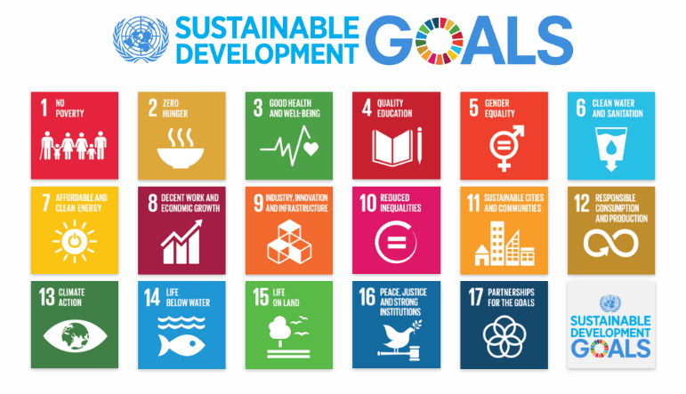
What are the SDGs?
The Sustainable Development Goals (SDGs) are a global collection of 17 interlinked goals designed to be a "blueprint to achieve a better and more sustainable future for all" by 2030. Set in 2015 by the United Nations General Assembly, these goals cover a broad range of social, economic, and environmental development issues. The SDGs are intended to be achieved by all countries, and they aim to address the global challenges we face, including those related to poverty, inequality, climate change, environmental degradation, peace, and justice.

Slide 12
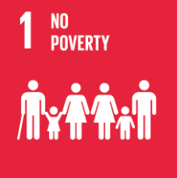
Agroecology and its impact on the SDGs
In this section, we are going to highlight the impact Agroecology has on several of the UN Sustainable Development Goals. It is very evident how aligned the 10 elements of Agroecology are with the SDGs. Agroecology contributes to these goals in various ways…
Poverty Alleviation: Agroecology enhances the economic well-being of small-scale farmers and reduces rural poverty by diminishing their dependence on external resources, subsidies, and market price fluctuations. Agroecology can enhance economic resilience by ensuring stable income throughout the year and establishing direct connections between customers and producers. This, in turn, improves bargaining power and minimises profit loss, especially when governmental policies offer support, access to finance, and safe markets.

Slide 13
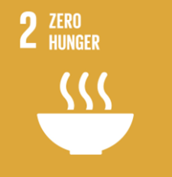
Agroecology and its impact on the SDGs
Zero hunger, food security, nutrition & health: Agroecology advocates cultivating diverse, robust, and sustainable territorial production systems that enable the year-round integrated production of healthful and nutritious foods. The approach aims to promote local, stable, and varied diets. Agroecological methods in farms and ecosystems can improve food security in four key aspects: availability, access, stability, and utilisation. It helps to reduce rural poverty, increase resilience, foster local development, and boost the livelihoods of communities.
Gender Balance: Agroecology utilises communal efforts to overcome power imbalances that promote prejudice and oppression, reducing gender disparity and promoting solidarity. Women are encouraged to incorporate agroecology into their daily routines by engaging in activities such as conserving and propagating indigenous seeds, cultivating nutritious and diverse food without the use of pesticides, breeding local and indigenous livestock species, advocating for the conservation of local biodiversity and landscapes.

Slide 14
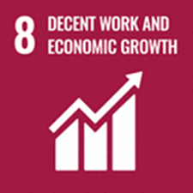
Agroecology and its impact on the SDGs
Youth & Less advantaged Engagement: Agroecology offers novel solutions and gives satisfactory career opportunities for young & less advantaged individuals. Agroecology is a form of agricultural production that relies on knowledge-sharing practices, prioritises environmental sustainability, promotes social responsibility, encourages innovation, and requires trained personnel. Agroecology is a grassroots approach to sustainable rural development that enables individuals and communities to take control of their transformation.
Human Rights: Agroecology promotes the integration of marginalised populations and the equitable distribution of resources for everyone. Agroecology encourages the fulfillment of the right to food by pushing for a human-centered approach, explicitly emphasising the most susceptible individuals. Agroecology advocates for the equitable, accountable, and open management of resources. This involves delegating authority to local and community leaders, granting them the capacity and ability to make decisions and take action.

Slide 15
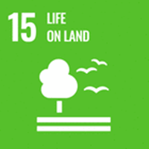
Agroecology and its impact on the SDGs
Climate change resilience: Agroecology safeguards, rehabilitates and enhances agricultural & food systems in response to climate disturbances and pressures. Agroecological systems that are diverse and well-integrated can improve the process of carbon sequestration and offer practical options for mitigating and adapting to climate change. These systems exhibit enhanced resilience to various societal shocks and stressors, including pandemics and market disruptions, through the re-localisation of food systems and the reduction of value-chain length.
Biodiversity: Integrated agroecological systems effectively maintain and improve natural functions and ecosystem services. These approaches also focus on restoring damaged soils, especially in drylands, positively impacting food security, resilience, and sustainable lifestyles. Various agroecological systems, such as polycultures, animal-integration systems, and agroforestry systems, utilize the advantages provided by ecosystems, such as pest management, pollination, soil health, and erosion control, while maintaining productivity.

Slide 16
03
Certification & Labelling

Slide 17
Understanding the Role of Certification & Labels…
Certificates and labels in agriculture, such as BIO, Organic, Fair Trade, Rainforest Alliance, Demeter Biodynamic, Non-GMO Project Verified, and Regenerative Organic Certification (ROC), are becoming increasingly commonplace.
They can play a crucial role in promoting agroecology by incentivising the adoption of sustainable farming practices, enhancing market opportunities for agroecological products, and raising consumer awareness about the environmental and social dimensions of food production.
While certifications are not synonymous with agroecology, they often serve as important tools for advancing sustainability within food and agriculture systems.
See the following slides to get more information on some of these Labels…

Slide 18
BIO- Label
1
This EU Label signifies that agricultural products have been produced in accordance with organic farming principles and practices, which prioritise environmental sustainability, biodiversity conservation, and animal welfare.
Consumers can trust that products bearing the BIO label have been produced without synthetic chemicals, genetically modified ingredients, or harmful agricultural practices, aligning with their preferences for healthier and more environmentally friendly food choices.

Slide 19
Fair Trade
2
Fair Trade certifications ensure that producers in developing countries receive fair prices for their products, adhere to social and environmental standards, and benefit from community development initiatives. Fair Trade promotes ethical trading relationships, social equity, and sustainable livelihoods for smallholder farmers and workers.

Slide 20
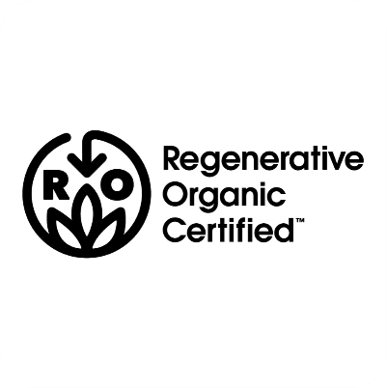
Regenerative Organic Certification
3
The Regenerative Organic Certification (ROC) programme goes beyond organic standards to promote regenerative agricultural practices that restore soil health, enhance biodiversity, and sequester carbon. ROC integrates organic, animal welfare, and social fairness criteria, emphasising holistic land management and ecosystem restoration and is very well aligned with Agroecology Systems.

Slide 21
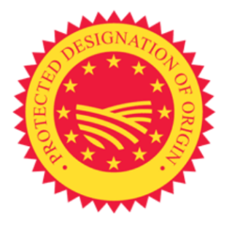
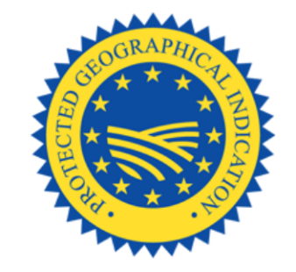
PDO & PDI
4
The Protected Designation of Origin (PDO) and Protected Geographical Indication (PGI) labels, established by the EU, indicate that a food product has been produced, processed, and prepared in a specific geographical area using traditional know-how.
PDO and PGI labels protect the quality, reputation, and authenticity of regional and traditional foods, supporting local economies and preserving cultural heritage.

Slide 22
Demeter Biodynamic Certification
5
This certification goes beyond organic standards to promote holistic farming practices that regenerate soil health, enhance biodiversity, and foster ecological balance.
Biodynamic farming integrates spiritual and cosmic principles with ecological agriculture, emphasising the interconnectedness of soil, plants, animals, and the cosmos.

Slide 23
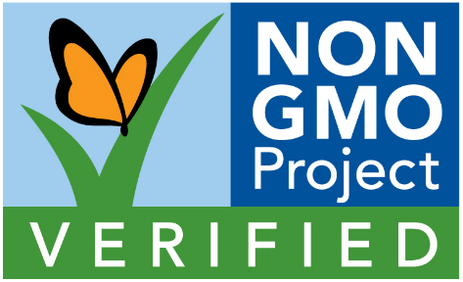
Non-GMO Project Verified
6
This label indicates that a product has been tested and verified to be free from genetically modified organisms (GMOs) according to rigorous standards. Non-GMO Project Verified products support consumer preferences for non-GMO foods and promote transparency and traceability in the food supply chain.

Slide 24
Rainforest Alliance
7
This certification promotes sustainable agriculture, forestry, and tourism practices that conserve biodiversity, protect ecosystems, and support the well-being of local communities. Certified products meet rigorous environmental, social, and economic criteria, including criteria related to agroecology such as biodiversity conservation, soil health, and integrated pest management.

Slide 25
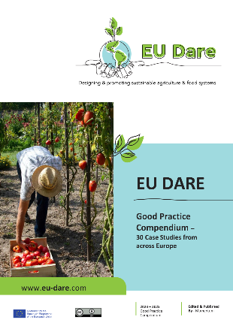
Be Inspired…
In The Sustainable Regenerative Farming Systems Guide and learning tool, one of the case studies…Castlewood Organic farm, demonstrates the effectiveness of gaining awards, labels and certification. They have received certification from the Irish Food Board to identify their meat as Organic, which is adding value to their products via this mark of quality and authenticity.
Read the full story

Slide 26
04
Food & Agricultural Associations

Slide 27
Association Roles
Food & agricultural associations are essential for European smallholders as they provide valuable support, resources, and opportunities for collective action, market access, policy influence, and community development.
By empowering smallholder farmers and strengthening their capacity to organise, collaborate, and advocate for their interests, these associations contribute to the sustainability, resilience, and vitality of rural communities and agricultural systems in Europe.

Slide 28
Agroecology Networks and Platforms:
International, European, and regional networks and platforms also play a crucial role in promoting agroecology by facilitating knowledge sharing, policy dialogue, and collaboration among stakeholders. These networks bring together governments, researchers, farmers, civil society organisations, and other actors to exchange experiences, share best practices, and advocate for supportive policies and investments in agroecology.

Slide 29
Local and Community Initiatives:
At the local level, communities, municipalities, and grassroots organisations and associations often play a critical role in promoting agroecology through local food policies, land use planning, community-supported agriculture (CSA) schemes, and participatory resource management initiatives.
These bottom-up approaches empower local stakeholders to develop context-specific solutions and promote agroecological practices that are tailored to local needs and priorities.

Slide 30
Some Benefits for Farmers in Joining Agricultural Associations & Networks…
Climate Change Adaptation and Mitigation
Fair Prices and Market Access
Land Tenure & Access to Resources:
Environmental Sustainability
Social Justice and Equity
Food Sovereignty and Local Food Systems

Slide 31
Some Useful Links for Associations & Networks in Ireland
Irish Farming Association
CAP Network Ireland
Talamh Beo
Agriland
That's Farming - Latest Farming News from Ireland
Farming for Nature
OGI | Organic Growers of Ireland
Irish Organic Association
Leitrim Organic Farmers
ARC | Agriculture & Rural Convention
NOTS – National Organic Training Skillnet

Slide 32
Some Useful Links for Associations & Networks in Poland
CDR - Centrum Doradztwa Rolniczego w Brwinowie (Agricultural Advisory Centre)
Strona główna - ZWIĄZEK ZAWODOWY PRACOWNIKÓW ROLNICTWA W RZECZYPOSPOLITEJ POLSKIEJ (zzpr.org.pl)(Agricultural Workers Union)
KZRKiOR | Krajowy Związek Rolników i Organizacji Rolniczych (kolkarolnicze.pl) (National Union of Farmers, Cooperatives and Agricultural Organisations)
KSOW (National Network of Rural Areas)

Slide 33
Some Useful Links for Associations & Networks in Italy
Campagna Amica (campagnamica.it)
Coldiretti – PUGLIA
Confagricoltura Foggia
Legacoop Puglia - Valori, Imprese, Persone
FederBio. Il biologico italiano in movimento
genuinoclandestino.it
CampiAperti - Agricoltura biologica e mercati contadini per l'autogestione alimentare
CIA - Agricoltori Italiani – Home
Chi siamo - Slow Food - Buono, Pulito e Giusto.

Slide 34
Some Useful Links for Associations & Networks in Slovakia
Poctivé dobroty (almasun.sk)
Úvod | OlejHont.sk
nahaji.sk
VIPA - Vidiecky parlament | VIPA
Domov - ASYF - Združenie mladých farmárov Slovenska
New Edu, n.o.
Domov - Vitajte na farme VEGGET
Domov – VPMS
Zväz chovateľov oviec a kôz - so sídlom v Banskej Bystrici (zchok.sk)
Vítame Vás | izpi.sk

Slide 35
Some Useful Links for Associations & Networks in Czechia
Zemedelec.cz – zpravodajství ze všech oborů zemědělství
eAGRI | eAGRI
Home (bioinstitut.cz)
ČMSZP | Českomoravský svaz zemědělských podnikatelů (cmszp.cz)
Homepage - ČMZU (cmzu.cz)
Zemědělský svaz ČR (zscr.cz)
Informační systém PK ČR – Foodnet
The Young Agrarians´Society of the Czech Republic (YAS CR) | Společnost mladých agrárníků České republiky, z. s. (smacr.cz)

Slide 36
Some Useful Links for Associations & Networks in Austria
Lower Saxony Chamber of Agriculture (lwk-niedersachsen.de)
Home | AMA - AgrarMarkt Austria
Austrian Farmers' Union (bauernbund.at)
BIO AUSTRIA - Organic farmers (bio-austria.at)
ÖKL | ÖKL (oekl.at)
Agriculture, Food and Climate in Austria (landschafftleben.at)
Institute – Institute of Food Science and Human Nutrition – Leibniz University Hannover (uni-hannover.de)
Home - ReSoLa e.V. (resola-ev.de)

Slide 37
Interactive Map
To have easy access to all these associations and networks please find our interactive map on the project website www.eu-dare.com

Slide 38
Well Done!!! You are doing great…keep going on this learning journey.
In Module 3 we discuss Building Bridges between Agroecology & the Community.

